Slide 1


New Medicaid Policies and Procedures Training for Nursing Facilities
Division of Eligibility Policy
July 26, 2017

Slide 2
Section 1: Identity Verification Policy and Procedures
Division of Eligibility Policy
July 26, 2017

Slide 3

Discussion Points
Purpose of Identity Verification
Identity Verification Hierarchy
  Electronic Data Sources
  Other Documentation of Identity
  Affidavit of Identity

Slide 4
Purpose
To streamline the identity verification process for individuals applying for Medicaid
  A photo ID is not required as part of the application submission
  ESA will leverage electronic data sources to verify an individual’s identity

Slide 5
Identity Verification
Verification of Identity by Medicaid
  42 CFR § 435.407(d)
Other Documentation of Identity
  Finding of identity from a Federal or State agency
    42 CFR § 435.407(c)(2)
  Acceptable Forms of Identification
    42 CFR § 435.407(c)(1)
Affidavit of Identity
  42 CFR § 435.407(c)(3)

Slide 6
Identity Verification Cont.…
Federal requirements at 42 CFR § 435.407(d) state a Medicaid agency may rely, without further documentation of citizenship or identity, on a verification of citizenship made by a Federal agency or another state agency.
Economic Security Administration (ESA) will use the below electronic data sources to verify identity:
  State Verification & Exchange System (SVES)
  Systematic Alien Verification of Entitlements (SAVE) Program

Slide 7
Identity Verification Cont.
Other Documentation of Identity (42 CFR 435.407(c)(2) )
The agency may accept as proof of identity a finding of identity from a Federal agency or another State agency, including but not limited to a public assistance, law enforcement, internal revenue or tax bureau, or corrections agency, if the agency has verified and certified the identity of the applicant.

Slide 8
Identity Verification Cont.
Federal and State Benefits
As a condition of eligibility, Medicaid will accept the applicant’s enrollment in Federal and State benefit programs since their identity has been verified. Examples of Federal and State programs are as follows:
Federal benefit programs
  Medicare
  Supplemental Security Income (SSI)
  Social Security Disability (SSDI)
  Social Security Benefits
District of Columbia (DC) State benefit programs:
  Temporary Assistance for Needy Families (TANF)
  Supplemental Nutrition Assistance Program (SNAP)
  Energy Assistance
NOTE: If the applicant has received benefits from another state and electronic data sources are not available, the applicant must provide documentation of benefits received in another state to ESA or from a Federal program.

Slide 9
Identity Verification Cont.
Acceptable Forms of Identity (42 CFR § 435.407(c)(1))
The agency must accept the following as proof of identity, provided such document has a photograph or other identifying information sufficient to establish identity, including, but not limited to, name, age, sex, race, height, weight, eye color, or address:

Slide 10
Identity Verification Cont.
ACCEPTABLE FORMS OF IDENTITY (cont.)
Identification containing Photograph or Other Sufficient Identifying Information
Voter registration card
Driver’s license issued by a State or Territory
US military card or draft record
Military dependent’s ID card
For a child under 19 years old, a clinic, doctor, hospital, or school record including preschool or day care records.
School ID card
ID card issued by the Federal, State, or local government
US Coast Guard Merchant Mariner card
A finding of identity from an Express Lane agency
Two other documents containing consistent information that corroborates an applicant’s identity, including but not limited to: employer ID card, high school/equivalent and college diplomas, marriage certificates, divorce decrees, and property deeds or titles.

Slide 11
Identity Verification Cont.
Affidavit of Identity (42 CFR § 435.407(c)(3) )
If the applicant’s identity cannot be verified by an electronic data source or other documentation of identity, the agency must accept an Affidavit of Identify.
The affidavit must be signed under penalty of perjury, by a person other than the applicant who can reasonably attest to the applicant's identity, and must contain the applicant's name and other identifying information.
The affidavit does not have to be notarized.

Slide 12
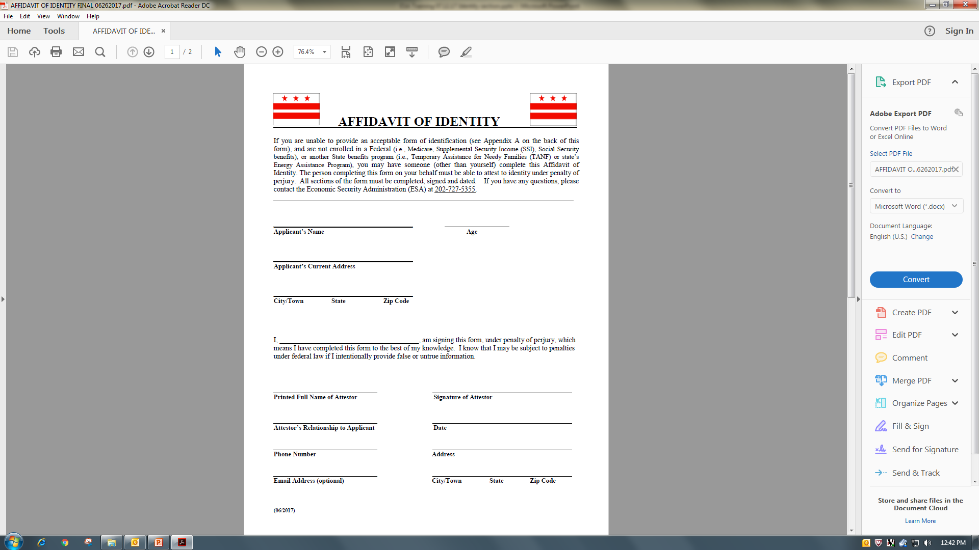
Sample of Affidavit of Identity

Slide 13
Section 2: New Medicaid Application Submission Process
Division of Eligibility Policy
July 26, 2017

Slide 14
Submission of Medicaid Application during Medicare Stay
To streamline the Long Term Care (LTC) application process to allow Medicare recipients to apply for Medicaid during their Medicare coverage days.
Only nursing facility residents who intent to remind in the nursing facility on a long term care basis need to submit a LTC Medicaid application.
Residents who are only in nursing facility for short stay like rehabilitation and intent to return to the community are not consider LTC Medicaid.

Slide 15
Medicaid Long Term Care Payment
By law, Medicaid is the payer of last resort and all other insurers including Medicare must meet their legal obligation to pay claims before the Medicaid program pays for the care of an individual eligible for Medicaid.

Slide 16

Medicaid LTC Application Process for Individuals who are receiving Medicare Coverage
A Medicaid LTC application may be submitted to ESA during an individual’s Medicare pay days.
In order for the application to be considered complete and registered in ACEDS ESA must receive:
  The signed and completed Medicaid LTC application
  The Request for Action 1346
  The current Level of Care Form

Slide 17
Medicaid LTC Application Process for Individuals who are receiving Medicare Coverage
The provider will indicate on the 1346 whether the applicant has Medicare coverage and when that coverage will end.
Medicaid Long Term Care coverage will start when the individual meets all non-financial and financial eligibility criteria.
If the applicant is not enrolled in Medicaid as a Qualified Medicare Beneficiary (QMB), the individual will be evaluated for QMB coverage as well.
Patient pay responsibility begins the first day after the applicant’s Medicare coverage expires.

Slide 18
QMB
A QMB only application may be submitted through Quickbase. QMB only covers Medicare cost sharing.
A Long Term Care Medicaid application, Request for Action, and a Level of Care must be submitted if the applicant wished to be considered for Medicaid Long Term Care.

Slide 19
Qualified Medicare Beneficiary (QMB) Income Limits
Federal Poverty Level (FPL) | 1 Person Household Monthly | 2 Person Household Monthly
QMB 300% FPL | $3,015 | $4,059
*** QMB has no resource test

Slide 20
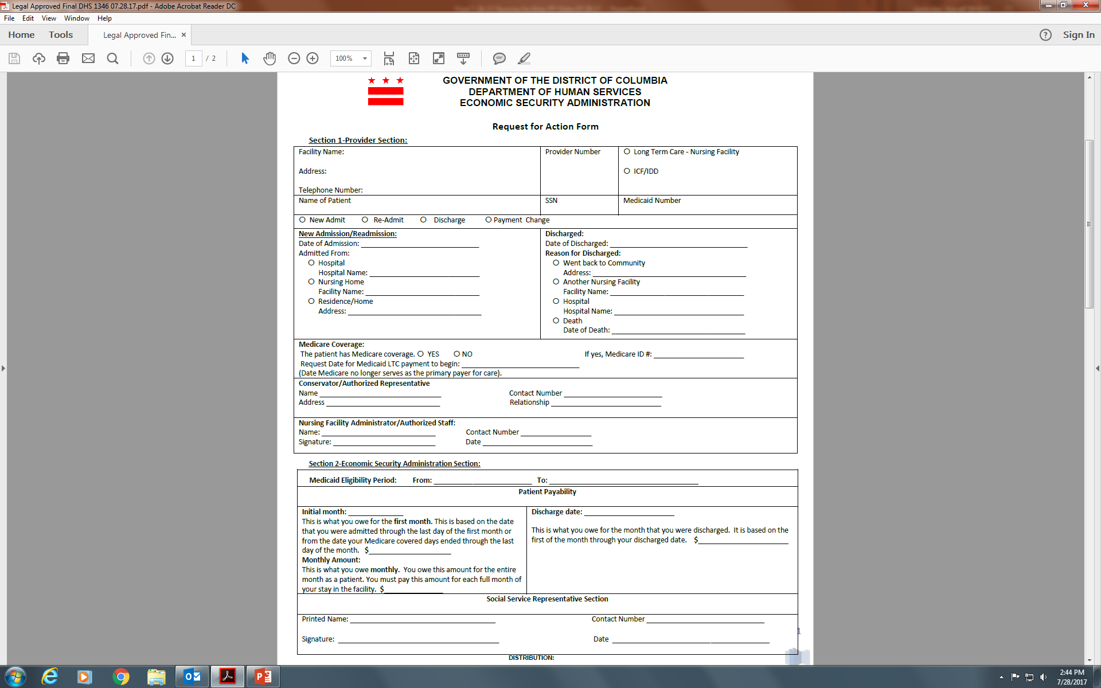
Request For Action Form 1346
Notes:
This is the Request for Action which now allows for the Nursing facility provider to indicate whether the individual has Medicare coverage and when that coverage will end.

Slide 21
Example
Jackie Mclean who is a Medicare beneficiary enters a nursing home on January 1, 2017. He applies for Medicaid on January 12, 2017 and determined eligible because he meets all non-financial and financial criteria for Medicaid LTC coverage. Swell Nursing Home submitted the required Request for Action which indicates Mr. Mclean has Medicare and his Medicare coverage days end on April 11, 2017.
Jackie Mclean is determined eligible for Medicaid so ESA enrolls him into Medicaid on January 1, 2017 which is reflected on the 1346. ESA completes 1346 showing the initial month of patient pay effective April 12, 2017 through April 30, 2017. The Request for Action will also reflect the beneficiary’s patient pay effective May 1, 2017 and ongoing.

Slide 22
What if the Applicant has Excess Income
If ESA evaluates the application and determines the applicant has income in excess of 300% of SSI and has Medicare coverage, the individual should be placed on a six month spend-down.
The spend-down begins the first day of the month of application and ends on the last day of the sixth month.
Incurred medical expenses that will not be paid by any other party may be submitted to ESA to meet the spend-down
In addition to other incurred medical expenses, ESA should use projected medical institution expenses when Medicaid become the primary payer through the end of the spend-down period to be considered an allowable expense to meet the spend-down and have Medicaid coverage.

Slide 23
Example
Paul Chambers who is a Medicare beneficiary enters a nursing home on January 1, 2017. He applies for Medicaid on January 12, 2017. His gross income from Social Security is $2,642.83. His countable income, $2,642.83 exceeds the 300% SSI income limit of $2,205. The Request for Action form indicates that Mr. Chambers’ has Medicare and his Medicare covered days ends on April 11, 2017.
Paul is placed on a six month spend-down effective January 1, 2017 through June 30, 2017. The spend-down is determined by subtracting the MNIL of $642.83 from Paul’s countable income of $2,642.83. The difference of $2,000 is multiplied by six to arrive at the spend-down amount of $12,000 effective January 1, 2017 through June 30, 2017.
Paul has no other medical expenses for which he is responsible which can be considered for spend-down. On April 12, 2017, ESA evaluates Paul’s projected medical expenses and enrolls him into Medicaid the first day of the month in which he meets eligibility April 1, 2017.

Slide 24
Example
Since Paul was not responsible for any medical institutional expenses from January 1, 2017 through April 11, 2017, ESA can only consider the projected medical institution costs that Paul is expected to incur from April 12, 2017 through June 30, 2017. ESA determines that the projected medical institution costs are $24,000. Since that expense exceeds Paul’s spend-down amount, Paul will be enrolled in Medicaid April 1, 2017. Paul’s patient pay responsibility will become effective April 12, 2017 through June 30, 2017.
Lastly, since Paul met his spend-down, ESA will process a second spend-down for July 1, 2017 through December 31, 2017. ESA should use Paul’s projected medical institution expenses to meet the second spend-down. ESA must complete a 1445 for the second spend-down.

Slide 25
Patient Pay
The patient pay responsibility for individuals who were previously covered by Medicare begins after the Medicare coverage days expire.
A prorated patient pay determination will be required if the Medicare coverage days end on any day other than the last day of the month.

Slide 26
Example
Max Roach’s Medicare coverage days expired on April 11, 2017. He has countable income of $1,070 from retirement. The only allowances that are applicable for Max’s patient pay determination is a personal needs allowance and a monthly Medicare premium of $100.
  The prorated patient pay determination for April is determined by subtracting his Medicare premium of $100 and the $70 personal needs allowance from his countable income of $1,070.
  The difference of $900 is divided by 30. The result, $30.00 is multiplied by nineteen to arrive at Mr. Roach’s prorated patient pay for April 2017
  The prorated patient pay is determined as follows:
    $1,070 Countable Income $900/30= $30 per day
    -70.00 Personal needs allowance $30 x 19= $570 patient pay effective April 12
    -100.00 Medicare premium through April 30, 2017
    $900

Slide 27
Example cont’d
Max Roach’s Medicare coverage days expired on April 11, 2017. He has countable income of $1,070 from retirement.
  $1,070 Countable Income
  -70.00 Personal needs allowance
  -100.00 Medicare premium
  $900.00 Max Roach’s patient pay effective May 1, 2017 and ongoing

Slide 28
Section 3: NURSING FACILITY ANNUAL Level of care ATTESTATION form
Division of Eligibility Policy
July 26, 2017

Slide 29
Discussion Points
Nursing Facility Annual Level of Care Attestation
When to Use the Form
How to Use the Form
Where to Send the Form

Slide 30
When to Use the Form
As part of the annual Medicaid renewal, the Nursing Facility Annual Level of Care Attestation Form must be completed for beneficiaries receiving Medicaid long term care.
The form replaced the DHS 1728 – Request for Medicaid Level of Care Form effective August 1, 2017.

Slide 31
Who can complete the form?
Only the Nursing Facility Physician or Advance Practice Registered Nurse (APRN) is authorized to complete and sign the attestation form.

Slide 32
How to Use the Form?
The physician or APRN must complete all of the below sections on the attestation form:
  Section I: Beneficiary Information
  Section II: Summary of Beneficiary’s Needs
  Section III: Summary of Beneficiary’s Health Status
  Section IV: Attestation
  If all sections are not completed and the document is not signed, the form will be considered incomplete and will be blocked by ESA.

Slide 33
Level of Care Process: No Change
If the physician checked “no change”, the nursing facility will submit the attestation form with the renewal packet to ESA.
Note: The form will not be sent to Delmarva
The NF will submit the form with the renewal packet to ESA through Quickbase.

Slide 34
Level of Care Process: Improved
If the physician checked “improved” the attestation form does not go to ESA. Instead the nursing facility will request a reassessment prior to submitting a renewal package to ESA by completing the following steps:
  The physician must request a reassessment by submitting a Prescription Order Form (POF) directly to Delmarva via fax to (202) 698-2075.
  Delmarva has 5 business days to complete the assessment and issue a determination:
  A score of 9 or higher, the beneficiary still meets the LOC requirements.
  A score less than 9, the beneficiary does not meet the LOC requirements.
Once Delmarva makes the determination, nursing facility must submit the LOC with the renewal packet to ESA.
If ESA receives an attestation checked “Improved”, ESA will block the case in Quickbase.

Slide 35
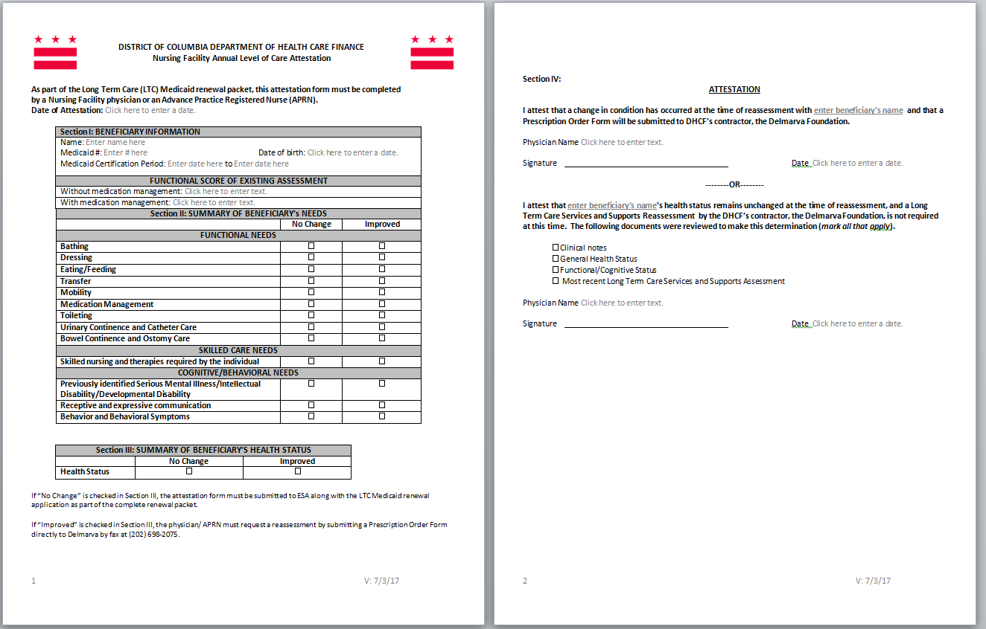
NF Attestation of Level of Care Form

Slide 36
Section 4: Overview of Request for Action (DHS 1346 FORM) and statement of Patient Payability
(DHS 1445 Form)
Division of Eligibility Policy
July 26, 2017

Slide 37

Discussion Points
Purpose of the Form
  DHS 1346 (Rev. 06/17)
  DHS 1445 (Rev. 06/17)
When to Use the Form
How to Use the Form
Where to Send the Form

Slide 38
Purpose
To streamline the Long Term Care (LTC) application process and communication of patient payability between nursing facility providers and ESA
Summary of Changes
  Removal of the Medicare cost –sharing eligibility span
  Revision of DHS 1346 to retire the use of the Patient Relocation Request Form to report patient discharge
  Elimination of the supervisor signature line from the forms

Slide 39
Request for Action Form
DHS Form 1346 has two sections
  Section 1 – Provider Section
  Section 2 – Economic Security Administration Section
What changed?
  Form Name: Request for Action
  Addition of discharge section with details on relocation information
  Elimination of Medicare cost sharing eligibility span dates
  Separate sections for Medicaid eligibility period and patient payability
  Elimination of the supervisor signature line
  Note: Continue to use the Long Term Care-Nursing Home Worksheet to calculate patient payability amount

Slide 40
When to Use the Form
Nursing facility staff must complete and submit a DHS 1346 to ESA;
At initial application
  Not required at renewal
Readmission
Payment Change request
  Nursing facility staff must submit a payment change request if the Medicaid LTC payment begin date previously reported has changed
Discharge
  Nursing facility staff must report patient discharge within 2 business days to ESA except hospital discharge
  For hospital discharge, the timeline with be 18 business days (bed hold days) + 2 business days (per DHCF guidance).

Slide 41
Section 1- Provider Section
Nursing facility staff must complete section 1 and submit the completed form to ESA.
  Facility Name
  Facility Address
  Telephone number
  Provider number
  Facility type – Long Term Care Facility
  Name of Patient
  Patient’s Social Security Number
  Patient’s Medicaid number (if any)
  Request Type (New Admit, Re-Admit, Discharge, Payment Change)
  Medicare Coverage information
  Conservator/Authorized Representative information
  Nursing Facility Administrator/Authorized Staff information
  Note: It is the responsibility of the nursing facility staff to provide the date when Medicaid LTC payment begins (Medicare no longer serves as the primary payer for care)

Slide 42
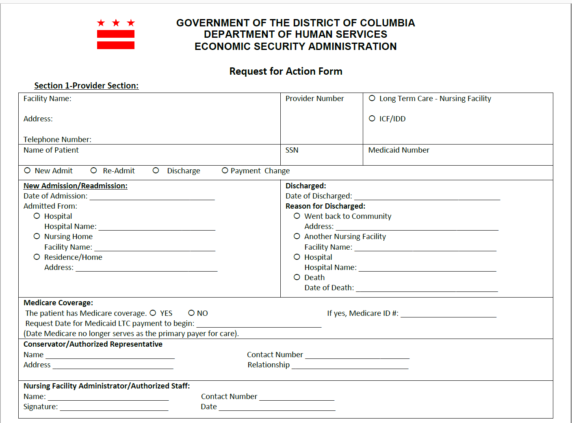
Request for Action Section 1 Snapshot

Slide 43

Section 2- Economic Security Administration Section
ESA must inform the nursing facility provider of the patient’s Medicaid eligibility and patient payability by completing section 2 of the form
  Medicaid eligibility period
    Begin date
    End of certification date
  Patient Payability
    Initial month (if applicable, prorated amount)
    Monthly amount
  Authorized Social Service Representative (SSR)
Once completed, ESA must forward a copy of the form as listed on the distribution section

Slide 44
Request for Action Section 2 Snapshot

Slide 45
Statement of Patient Payability Form
DHS 1445: Statement of Patient Payability
  ESA uses DHS 1445 to communicate patient payability to nursing facility providers
What changed?
  Minor changes
    Initial month and monthly amount sections consolidated into one (1) renewal month section
    Supervisor’s signature line eliminated

Slide 46
When to Use the Form
ESA must complete a DHS 1445 to communicate any changes on the patient payability amount at;
  Renewal /Recertification
  Payment Change
  Reconciliation
  Discharge
  Approval of second six month spend down budget period

Slide 47

How to Use the Form
ESA must complete the DHS 1445
  Name of facility
  Provider Number
  Facility type: Long Term Care –Nursing Facility
  Action type
    Recertification
    Payment Change
    Reconciliation
    Discharge
    Spend down
  Start Date
  Name of Patient
  Social Security Number
  Medicaid ID number
  Calculation patient payability amount
    Allowances
    Income
  Monthly patient payability amount (renewal month section)
  Discharge information (if applicable)
  Eligibility Coverage period
  Social Service Representative information

Slide 48
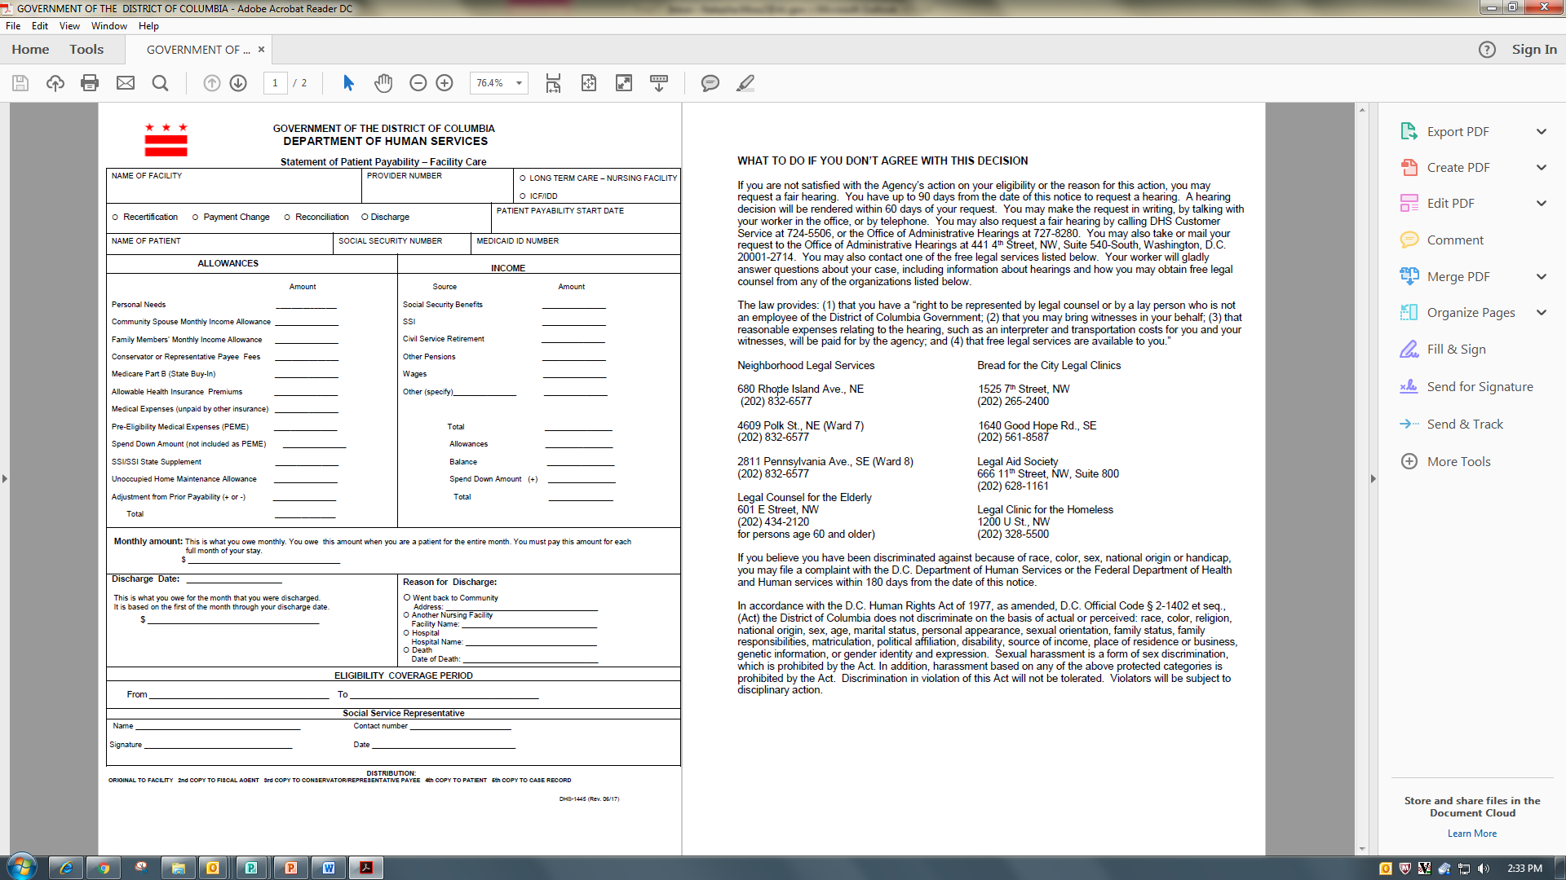
DHS Form 1445 (Rev. 06/17) Snapshot

Slide 49

Where to Send the Form
A copy of the completed DHS Form 1346 and DHS Form 1445 must be distributed as follows;
  Original to the facility/provider
  Copy to Fiscal Agent (Conduent)
  Copy to Conservator/Authorized representative
  Copy to the patient
  Copy to case record

Slide 50
SECTION 5: Medicaid Evaluation of Financial Institution Accounts and the Asset Verification System
Division of Eligibility Policy
July 26, 2017

Slide 51
Discussion Points
Background
Financial Institutions
Types of Financial Institution Accounts
What Has Changed?
Resource Limits
Evaluating the Money Held In Financial Institution Accounts
How AVS Works
Summary

Slide 52
Background- Asset Verification System
Federal regulations require all states to implement a program to verify an applicant/beneficiary’s money held in financial institutions.
Groups with resource test include Aged, Blind, and Disabled category and LTC Medicaid
Notes:
By law, the District and states that have Medicaid programs must employ an electronic asset verification process to verify the financial institution accounts of all ABD and LTC applicants and beneficiaries

Slide 53
Financial Institutions
Medicaid considers monies held in financial institutions to be resources when determining eligibility. Financial institutions include:
    Banks
    Credit Unions
Notes:
Medicaid defines financial institutions as banks and credit unions.

Slide 54
Types of Financial Institution Accounts
The following financial institution accounts are verified by the District’s Asset Verification System (AVS) and will be evaluated when determining eligibility for Medicaid:
Checking Accounts
Savings Accounts
Certificate of Deposit Accounts
Money Market Accounts
Christmas Club Accounts
Notes:
The types of accounts that will be verified by AVS and evaluated by ESA include checking accounts, savings, CD accounts, Money Market Accounts, Christmas Club Accounts

Slide 55
What Has Changed?
AVS is the primary source for ESA to verify financial institution accounts.
If the bank account information is verified through AVS, the ESA worker does not need to send a checklist to verify account balances.
If the applicant/beneficiary has a financial institution account, but it cannot be verified by AVS, the worker may need to send a checklist.
AVS will send a response when a verification cannot be obtained.

Slide 56
Resource Limits
Household | Single Person | Married Couple
Aged, Blind, Disabled Applicant/Beneficiary (Community Medicaid) | $4,000 | $6,000
Long Term Care Applicant/Beneficiary Either Institutionalized or in an Home and Community Based Services Waiver | $4,000 | Not Applicable An individual who is applying for Medicaid Long Term Care Services is always a household of one

Slide 57
Evaluating the Money Held In Financial Institution Accounts
If the countable value of the individual’s money held in financial institution accounts plus the countable value of the individual’s other resources exceeds the applicable resource limit, the individual is ineligible for Medicaid.

Slide 58
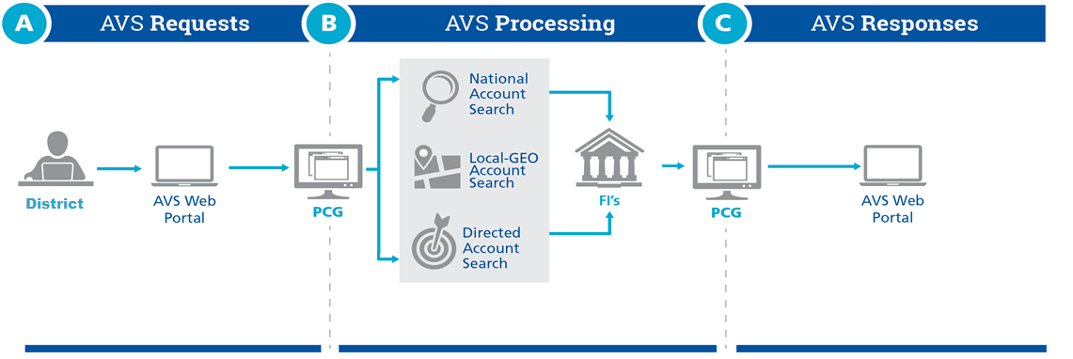
How the District of Columbia’s AVS Works:
Comprehensive Asset Search
National account search for any accounts maintained by 20 largest banks.
Local account search based on geographic proximity.
Directed account search to query any financial institution.
Notes:
Once a case is registered in ACEDS, it is added to a file which includes the other cases for that day. Its fed into the AVS portal and our partner PCG processes it. The largest national banks such as Suntrust and Chase are included in PCG’s National network. So if the applicant opened a Suntrust account in Richmond, Virginia, AVS picks that account up automatically. AVS also does a local search for banks in the District and surrounding counties in Virginia and Maryland. So if an individual belongs to Falls Church Credit Union which is not national, AVS picks that up. There are also Direct Account searches or Ad Hoc Searches that can be completed.

Slide 59
In Summary
AVS is ESA’s primary source for verifying the resource value of financial institution accounts for ABD and LTC Medicaid applicants/beneficiaries.
This should make the application/renewal process more efficient by reducing the issuance of checklist from ESA.

Slide 60
SECTION 6: long Term Care Medicaid Spend-down Changes
Division of Eligibility Policy
July 26, 2017

Slide 61
Discussion Points
Purpose of the Spend-down Changes
Background
Summary of Changes
The Result

Slide 62
Purpose- Spend-Down Budget Period Alignment
The purpose of this process change is to eliminate renewal notices from being issued to Medicaid LTC Spend-down beneficiaries in the fourth month of spend-down.

Slide 63
Background
Medicaid Long Term Care Beneficiaries who became eligible for Medicaid through spend-down received renewal forms at the beginning of the 4th month of their spend-down.

Slide 64
Summary of Changes
System changes have been implemented for new Medicaid beneficiaries to eliminate the issuance of renewal forms during the fourth month of the beneficiary’s spend-down budget period starting August 2017.
This system change will be effective for enrolled Medicaid Long Term Care Spend-down beneficiaries (318/318Q) effective November 1, 2017. Nursing facility staff are still encouraged to help Medicaid beneficiaries submit renewal information until the change is made in November 2017.

Slide 65
The Result
Beneficiaries will no longer receive renewal packets at the beginning of 4th month of their spend-down period which will result in a more streamline process for ESA, the beneficiary, and the nursing facility.

Slide 66

Questions

Slide 67

Contact Information
Danielle Lewis-Wright
Associate Director
Email: Danielle.Lewis@dc.gov
Anthony Proctor
Management Analyst
Email: Anthony.Proctor3@dc.gov
Gary Watts
Management Analyst
Email: Gary.Watts@dc.gov
Araceli Simbulan
Program Analyst
Email: Araceli.Simbulan@dc.gov
Natasha Moss
Program Analyst
Email: Natasha.Moss2@dc.gov

Slide 68
Contact Information for Questions Regarding Medicaid Payment During Medicare Stay Days
Ann (Bernie) Thomas
Management Analyst
Ann.thomas4@dc.gov
Suprenia Robinson
Management Analyst
Suprenia.robinson@dc.gov
Monique Willard, MHA
Management Analyst
Monique.willard2@dc.gov

