Slide 1



A Revolution in Resident Engagement
Present By:
Devin Kassi, PT, DPT
Gravity Healthcare Consultant
and
Rob Liebreich
Executive Director of Asbury Methodist Village
Notes:
Introduce Rob

Slide 2
Objectives
Insight Into the Importance of Resident Engagement
Statistics Regarding Resident Engagement
Provide an Example of a Revolutionary Engagement Program

Slide 3
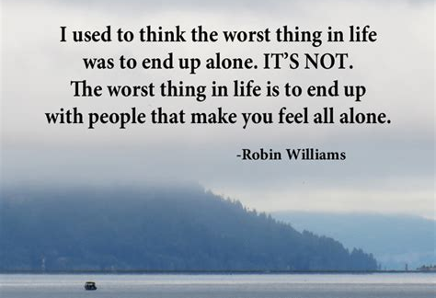
Notes:
Reference residents being in SNF/LTC and having people all around them, but still feeling isolated, not engaged, and alone.

Slide 4
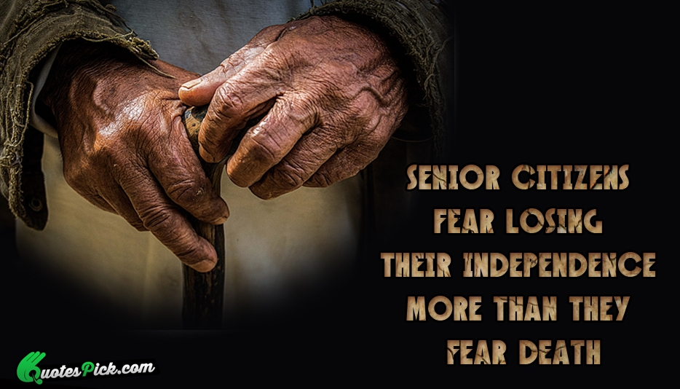
Notes:
Senior citizens fear moving into a nursing home and losing their independence more than they fear death, according to a study, “Aging in Place in America,” commissioned by Clarity and The EAR Foundation, which also found that the Baby Boomer children of seniors also fear for their parents.
When asked what they fear most, seniors rated loss of independence (26%) and moving out of home into a nursing home (13%) as their greatest fears. Death was cited as the greatest fear for just 3% of seniors.
89% of seniors want to age in place – or grow older without having to move from their homes – and more than half (53%) are concerned about their ability to do so.
65% of seniors say they are open to or would like to use new technologies that enable independence.
What are we doing to educate and empower our residents to increase or maintain independence and have meaningful aging?

Slide 5
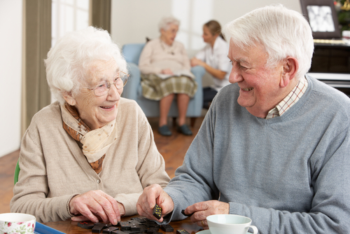

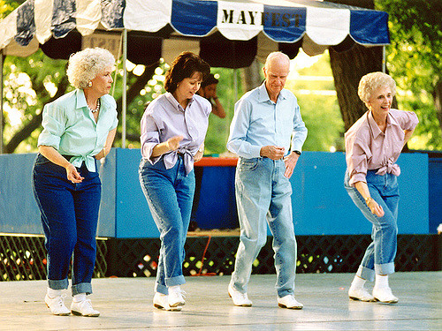
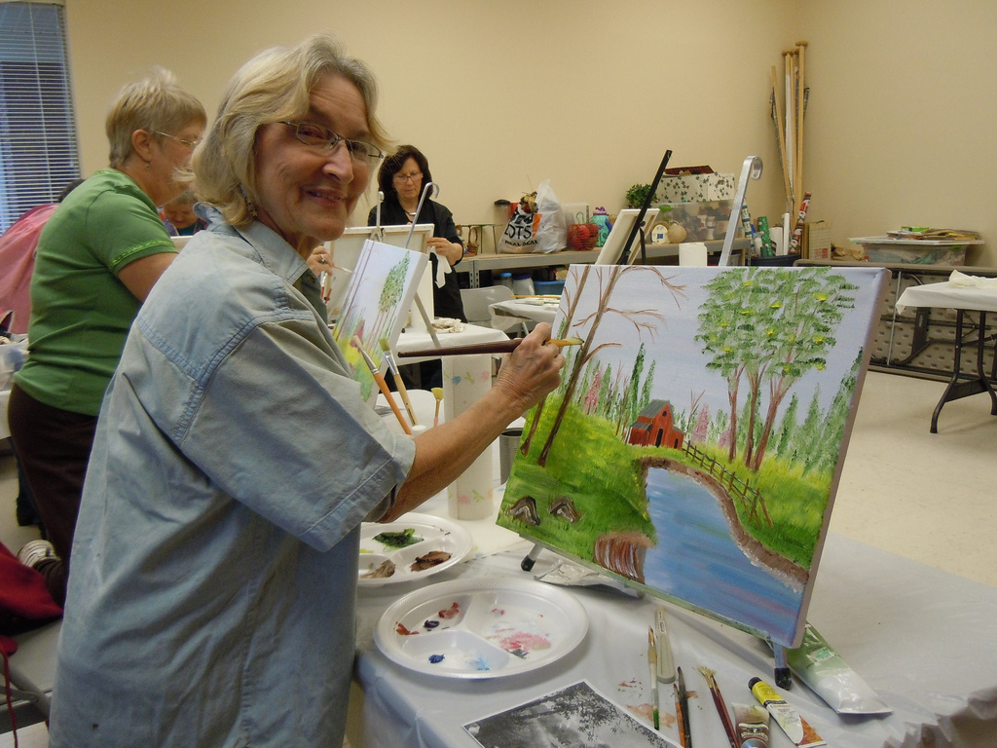
Successful vs. Meaningful Aging
Notes:
I recently read an article titled “What is Successful Aging?” Successful aging involves focusing on what is important to the individual, and being able to do what they want to in old age. The article also discussed the phrase “meaningful aging.” Meaningful aging focuses on what is most meaningful to the person, especially as they age. Meaningful aging encourages us all to find meaning and peace in our lives, and the effects that these practices have on how we age can in fact, lead to a form of successful aging.
Providing a variety of engaging choices involving nutrition, activities, events, and technologies will empower our residents to participate in meaningful practices to successful assist with their recovery, achieve their goals, and continue to positively impact their lives following discharge.

Slide 6


What Do You Think…..
… is the hardest part about being a short term skilled resident living in a SNF???
Notes:
(pause after reading slide) what could be done to improve the quality of life of residents???
After open discussion – introduce Rob again and have him discuss how and why IGNITE was created.

Slide 7

Inspiring
Growth &
Nourishing the Brains of
Individuals
Through
Engagement
Notes:
The next level of revolution for resident engagement has arrived! Gravity Healthcare Consulting in partnership with Asbury and Asbury Methodist Village have created IGNITE. A progressive Resident Engagement Program that has innovative concepts to keep seniors productive and connected to their families, friends, and community. The goal of this program is to encourage skilled residents and their families to actively explore and participate in various person – specific activities involving resident engagement, cognition, spirituality and mobility that incorporates technology applications, such as Cubigo and brainHQ . This program is available in addition to the resident’s plan of care. IGNITE uses a technology platform to boost participation in recommended activities and functional tasks along with excellence in clinical care and customer service. The result is improved outcomes and improved customer satisfaction, all while reducing or maintaining length of stay as clinically indicated. The entire Interdisciplinary Team has a role in the IGNITE Program to engage and motivate the residents to participate. This includes – Nursing, Admissions, MDS Coordinator, Therapy, Dietary, etc.
The IGNITE program acronym is
Inspiring
Growth +
Nourishing the Brain of
Individuals
Through
Engagement

Slide 8


What do residents do for the other hours of the day?
  2-3 hours therapy
  +8 hours sleep
  13-14 hours a day with little to no meaningful engagement
Notes:
Why IGNITE???

Slide 9
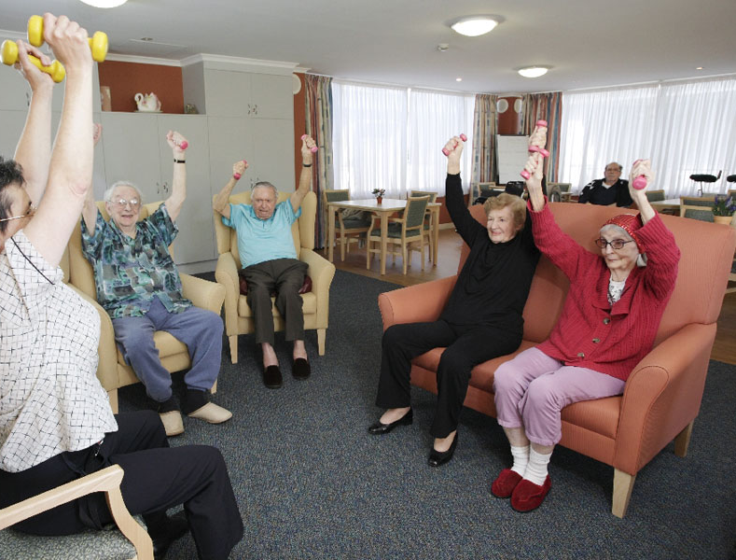
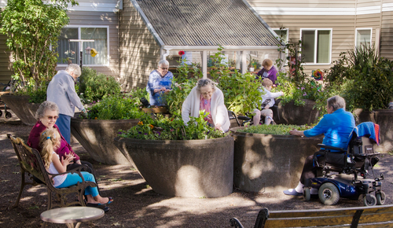


Notes:
Goals of the IGNITE Resident Engagement Program
Improve functional outcomes
Improve mental capacity and stability
Customized for various levels of independence
Decrease depression
Increase resident engagement
- Empower residents to make healthy food decisions
Decrease falls
Decrease resident length of stay while improving outcomes, resident satisfaction and reducing re-hospitalizations.
Utilize technology to enhance engagement, promote independence and drive improved cognition.

Slide 10

Promote Independence and Self-Sufficiency
Notes:
The resident engagement program improves a resident’s level of care through promotion of independence and self-sufficiency. Our initiative program includes a variety of activities, both cognitively and physically stimulating and designed to recognize, entertain, educate and empower the residents to actively participate in their progress towards returning to their home environment. Our program is aimed at enriching the lives of skilled residents throughout the course of treatment and continuing to impact their lives beyond discharge.
We want to motivate residents to continue participating in programs in their home environment and/or general community when they are discharged.

Slide 11
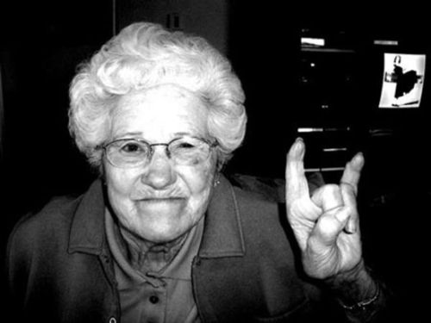

The Program
Detailed Roles and Responsibilities for each associate
Enhanced Activities Program focused on skilled residents
True collaboration between departments
Supporting the individual in self actualization
De-institutionalization in every way possible
Integration of technology and research

Slide 12
Team Members
Activities
RN and/or MDS Coordinator/RNAC
LPN
GNA/CNA
Physical Therapy
Occupational Therapy
Speech Language Pathologist
IT Department
Unit Manager/RN
Religious Support
Dining Services
Housekeeping
Social Services
Admissions
Dietary

Slide 13

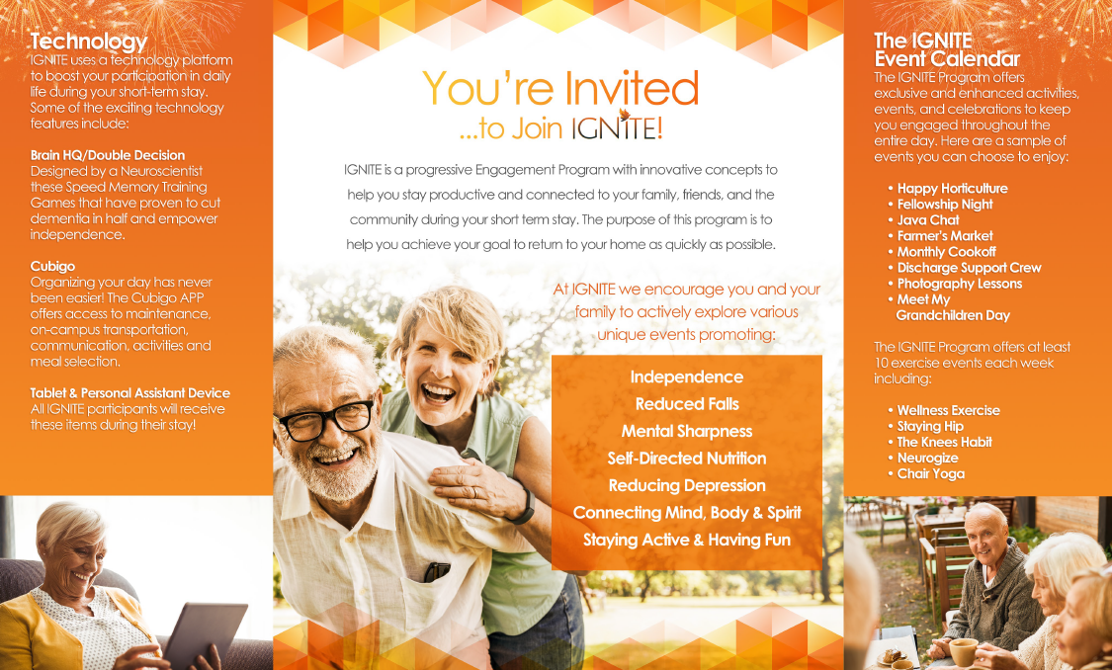
Pre-Admission Invitation
Invite potential clients to come and be a part of this unique program.
Educate about some of the features of the program, including:
  Tablet provided to every resident during their stay.
  Personal assistant (Google Home) provided bedside to every resident during their stay.
  Free subscription to Brain HQ/Double Decision during the stay.
  Contemporary and unique activities programs offered as part of the IGNITE program.
Notes:
Invite potential clients to come and be a part of this unique program – IGNITE includes this customizable invitation that you can use as pat of your marketing initiative and for pre-admissions hospital visits to help promote your census.
Educate about some of the features of the program, including:
Tablet provided to every resident during their stay.
Personal assistant (Google Home) provided bedside to every resident during their stay.
Free subscription to Brain HQ/Double Decision during the stay.
Contemporary and unique activities programs offered as part of the IGNITE program.

Slide 14



GNA/CNA: Walking Partner
Walk EVERY resident
EVERY day
3 TIMES per day
Notes:
Here is an example of one of the team member’s roles and responsibilities: (read slide)
As you can see, this is a reasonable and very functional approach to providing care that will help to promote all of the initiatives that matter most to you and to the resident.

Slide 15

Therapy: Focus on Function
ADLs/IADLs and ambulation x 3 EVERY DAY
Replace activity and exercise with functional tasks whenever possible
Function
Notes:
For therapy, one of the key changes is that the therapists in INGITE are required to focus on function every day!
For Ots and COTAs, this could be that they DO ADLs or IADLs WITH EVERY RESIDENT EVERY DAY. Residents can often achieve more through ADLs or IADLs than they can with exercise and therapeutic activity. Residents also value the functional tasks more.
Also, therapy will drive the resident’s participation in Double Decision, which we will discuss in just a minute.

Slide 16
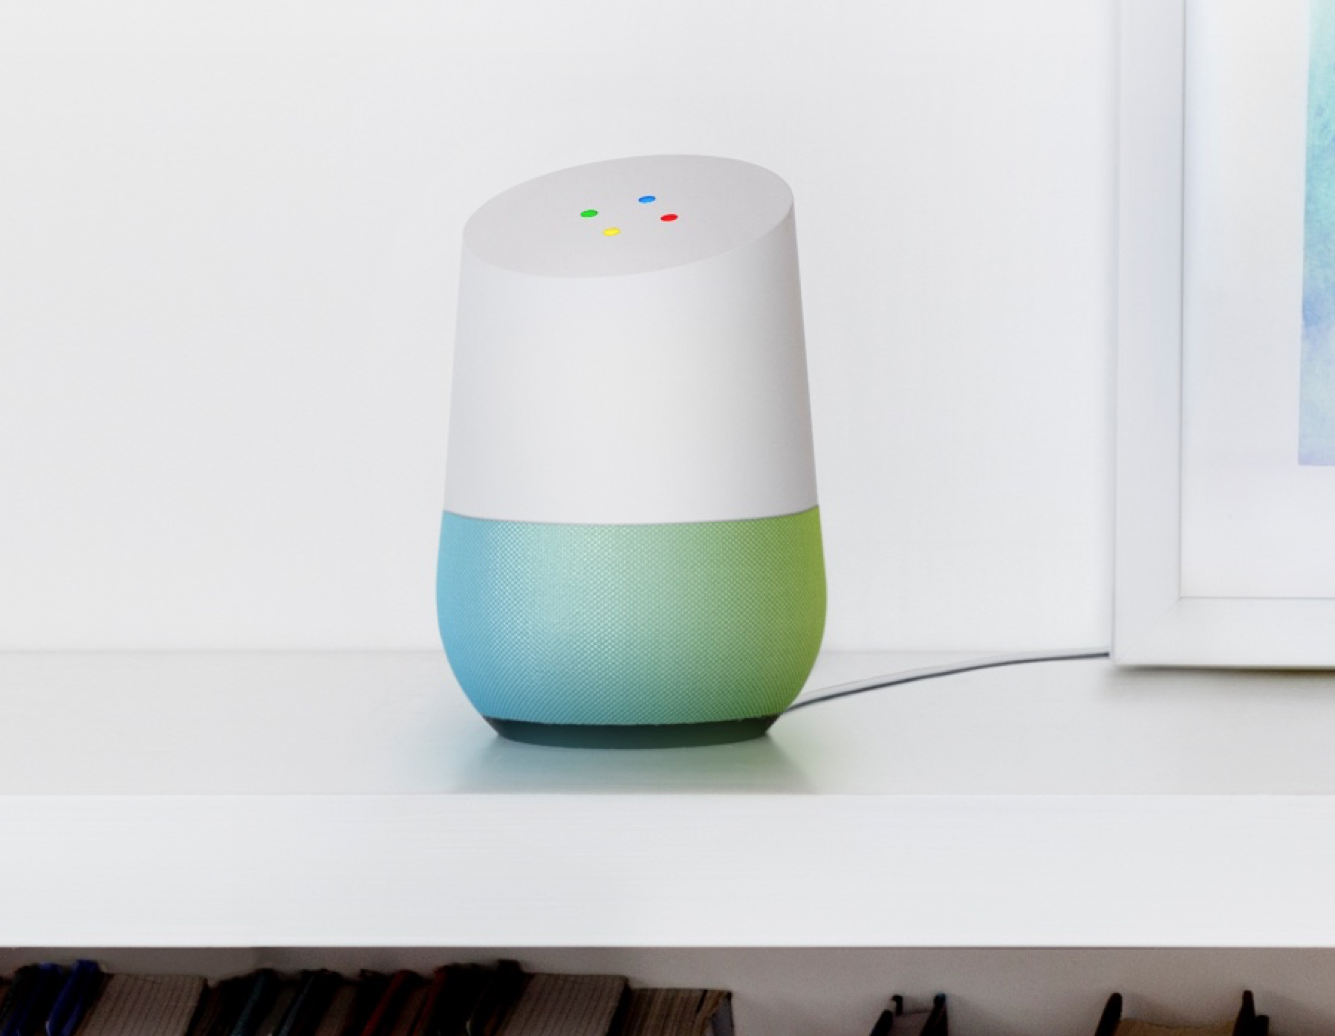
IT Department
Goggle Home Personal Assistant
  Best integration with geriatric voice
Cubigo
  RSVP activities
  Activities ratings
  On-campus transportation requests
  Meal selection
  Library access
Tablet for all residents during stay
Notes:
IT is a huge part of IGNITE and is a great way for your community to make this transition. Residents more and more are expecting access to technology and IGNITE helps your community to do just that!
Goggle home personal assistant
Best integration with geriatric voice
Cubigo
RSVP activities
Activities ratings
On-campus transportation requests
Meal selection
Library access
Tablet for all residents

Slide 17
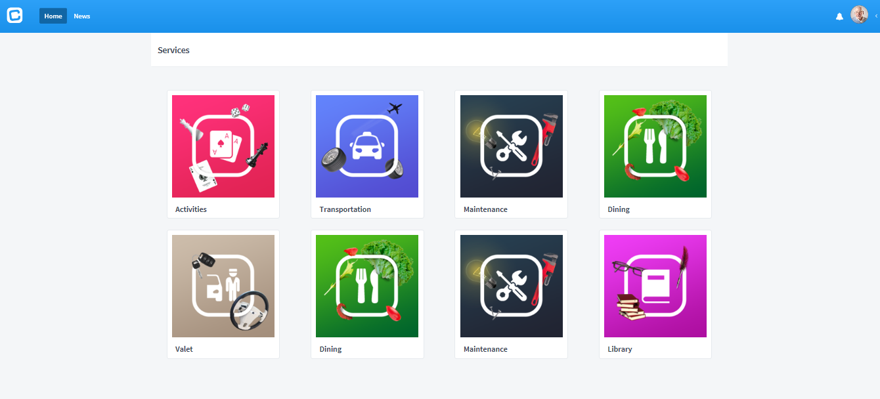
Cubigo
Notes:
What is Cubigo??? It is an activities and lifestyle app that is geared toward senior living and facilitates improved quality of life for the residents who use it.
So you can see some of the basic blocks available on Cubigo. In activities, residents can view and accept activities and then these activities will be uploaded to their home page and pop up on the days they are occurring.
The maintenance cube allows residents to put in a maintenance request, which can then be tracked through the ticket system to have real time responses and information about time to respond, etc.
Dining allows residents to self select meals, using a cut off time for each meal to assist the dietary department with efficiently completing meal service.
Valet would not be used in the skilled unit but would be more applicable to the CCRC.
The library allows users to access content through a local library, such as e books and audio books.
Residents would also be able to message each other (updated paperwork will need to be added to the admissions process for residents to sign off that they want to use Cubigo and that we can save their info that is stored while they are here.)

Slide 18
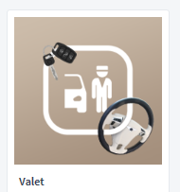
Cubigo
Customizations
Direct message activities to RSVP
  Integrate with Google home
One-drive Cube for reading and audio books
Survey after every meal and activity for anyone who RSVP’d
  Yelp style 5-star ratings with optional comments
A Twitter feed cube
Check box on admin side to display dietary restrictions
Modify transportation portal to be for in-house only transportation
Notes:
Cubigo is going to complete some specific customizations for the IGNITE program by Q2 (quarter 2) 2018, which will further help to improve the resident/family experience when using the app.
Direct message activities to RSVP, drop down box plus optional text box. Items to include: I’m running late, pick me up, I’m coming and will bring myself, I’m coming – please pick me up, Unable to attend
What is the availability to have this integrated with Google home in each room so the resident can instruct Google to RSVP for them?
One-drive Cube for reading and audio books (to sync with res. library cards)
Survey after every meal and activity we would like it to pop up for anyone who RSVP’d
Also there will be an option on the back end for the activities personnel to be able to check in residents so we have an accurate attendance list and then the survey pop ups will go to the correct residents
We would like a 5 star rating, optional text box and a check box for the resident to indicate “Yes – administration can contact me regarding this rating.” And otherwise, all ratings and comments would be anonymous.
Also, ratings would not post to the resident side of the portal, but just to the business side and include something on the dashboard for specific groups, meals and activities personnel ratings
Twitter feed cube
Check box on admin side to display what dietary orders fit certain food items Include boxes for: diabetic restrictions; kidney/renal restrictions; salt restrictions; Cardiac restrictions; Finger Foods; Gluten Sensitive; Finger Foods; Vegetarian; Vegan;
If no meal is ordered, can a default meal be sent to resident
Modify transportation portal to be for in house only transportation (no off campus transportation in the portal) for activities, therapy, salon, etc.

Slide 19

Dementia and Brain HQ
Alzheimer’s & Dementia: Translational Research and Clinical Interventions
Double Decision Game
  Specific “speed of processing” exercise
Linked with 29% reduction in dementia
Training for at least 13 hours cuts the risk for dementia in HALF
Notes:
So we want to shift gears and talk about a cornerstone of the INGITE program: brain HQ/Double Decision gaming system.
This is an advanced and research supported brain exercise program that is similar to something like Lumosity except there is more solid research and proof of its impact on reducing dementia and cognitive loss.

Slide 20

The Research: ACTIVE Study
10 years and 2,832 healthy older adults
Brain HQ/Double Decision
87% showed increase in cognitive ability
35% reduced risk of serious decline in health-related quality of life
Reduced risk of ADL decline
Cut risk of dementia in HALF
EFFECTS LAST 10+ YEARS WITHOUT FURTHER TRAINING
Notes:
(Read first) The ACTIVE study was designed to compare three different types of cognitive training: one that focused on memory, one that targeted reasoning, and BrainHQ training that exercised speed of processing. The study was conducted at six sites across the United States, and all of the participants were healthy adults aged 65 or older. Researchers followed participants for ten years to evaluate the long-term effects of training.
10 years and 2,832 healthy older adults
All three types of cognitive training tested in the ACTIVE study resulted in cognitive improvements after the initial training period, but participants who used the BrainHQ exercise experienced the best results overall. According to the study, 87% of the participants who used BrainHQ’s Double Decision showed increases in cognitive ability, while 74% of participants who used reasoning training and 26% of those who used memory training showed improvements. The Double Decision training also reduced the risk of serious decline in health-related quality of life by 35%, and reduced the risk of decline in people’s abilities to perform instrumental tasks of daily living.
EFFECTS LAST 10+ YEARS WITHOUT FURTHER TRAINING: That literally means that the Brain HQ/Double decision we do with a resident today during a short term skilled stay will literally impact their cognition and well being more than a decade from now!!! That’s a powerful impact!!!

Slide 21
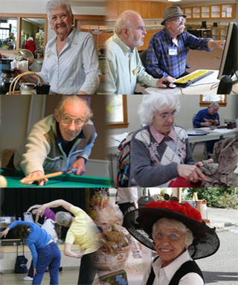
Resident Engagement Programming
Notes:
The IGNITE Resident Engagement Programming is geared towards engaging the skilled residents with socialization, interaction, and participation with community associates/residents, families, friends, and children to promote cognitive and physical stimulation for true person - centered care. This program is designed for general community volunteers and events to participate in programming at the skilled nursing community. We want to encourage people of all ages to participate, including children, high school students, and college students.

Slide 22

IGNITE Event Calendar
Notes:
Next we will review he IGNITE Event Calendar and define each activity. The activities and events developed for the residents is focused on skilled residents, but all residents in the skilled/LTC community are able to participate in any of the activities and events. The activities and events are geared towards stimulating cognition, physical activity, spirituality, and socialization that is resident specific and individualized to the goals of resident. The IGNITE program involves activities, events, celebrations, general community and IL/AL resident assistance and integration that encourages family and friends to participate with the residents. Programs are developed for utilization while in the community and when the resident returns to their home.

Slide 23
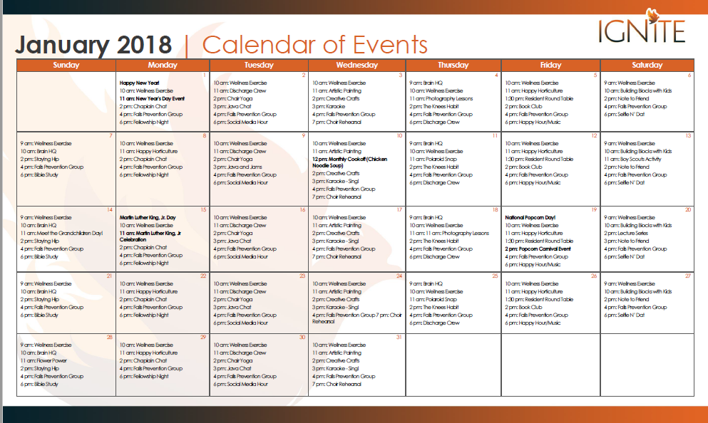
Notes:
This slide represents a snap shot of the IGNITE Events Calendar for June of 2018. Every day is filled with 5-6 activities or events for residents to choose to participate. There are a variety of activities and events utilized to engage residents cognitively, physically, socially, emotionally, and spiritually and many things you have never seen before….
The calendar for each month of the year will have these 30 different activities. Then on top of having these 30 activities offered throughout each month, there are specialized activities, events, and celebrations offered in each month. Some of these specialized programs are offered on a quarterly basis or specific to the month in which they are offered. After we review the 30 activities and events offered each month, we will then review all the specialized events for each month.

Slide 24
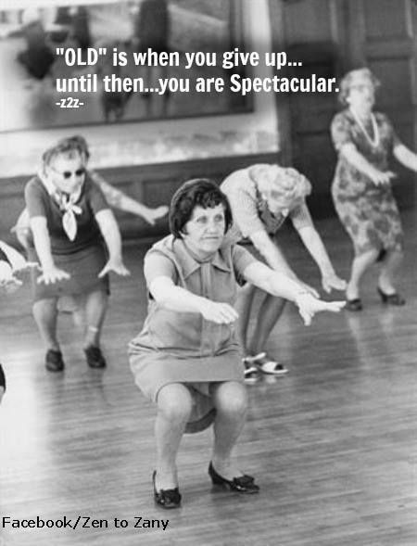
Specialty Exercise Groups
The Knees Habit
Staying Hip
Chair yoga
Neuro-gize
Wellness Exercise
Notes:
One of the key activities for IGNITE are focused exercise groups for higher level residents. These groups were custom designed by a PT on our team and include a total knee replacement group, total hip replacement group, chair yoga, CVA/neurological impairment exercise group and a general wellness exercise group. Our live onsite training, training videos and manuals contain demonstrations and tests to help your train your activities teams.

Slide 25

Chair Yoga Research
Notes:
The International Journal of Yoga evaluated seniors after an eight-week chair yoga trial, and found that the practice improved mobility and reduced anxiety and the fear of falling. A study published by the Journal of Gerontological Nursing showed chair yoga helped seniors with osteoarthritis to move better as it decreased stiffness.
And eCAM, a journal of complementary and alternative medicine, published a study that found 15 minutes of seated yoga significantly lowered physical and psychological stress in sedentary office workers.
We want to provide our short term and long term care residents with the opportunity to utilize chair yoga while at the community with hope they will participate in a Chair Yoga Class or other programs in the general community when they return home to increase outcomes and maintain/optimize the residents overall functional mobility and well-being.

Slide 26



Campus Farmers Market!
Notes:
Another exciting and unusual sample activity is– a weekly Farmers Market for the skilled unit!!
Residents could participate in purchasing items as part of their OT or ST, shopping the vendors while ambulating as part of PT, helping to run a booth, and being able to enjoy healthier, organic snack options.
We have a very detailed plan for each day what should be done to prepare for the weekly farmers market, including posting marketing materials on campus and in the SNF and arranging for outside vendors to come as well. We recommend that this Farmers Market be conducted at least May through October and that the public be invited. The proceeds can either be donated back to Activities or to another charity at the Administrator’s discretion.
This is the type of thing that is very Millennial friendly and may be one element that helps to improve your retention of Millennials as well.

Slide 27




YouTube Videos for Self Guided Meditation
Notes:
We have also included a playlist of self guided meditation for anxiety, depression, insomnia and general wellness. There are also a few links for spiritual Christian meditation, and youtube videos to laugh.

Slide 28
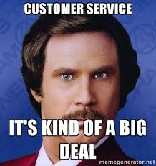
Customer Service
Notes:
Now we are going to discuss something very important to all of us and it is really at the heart and soul of everything we do: CUSTOMER SERVICE.
I want you to think about what it would be like if you were suddenly admitted to skilled care? What would you expect? What would make your stay more pleasant? What would infuriate you so much that you would leave early???
Think about how many times a resident who really needed rehab and nursing care left a SNF early because of poor customer service. This is something we never want to have happen to the residents in our care because ultimately the resident will suffer. So for us this was a no-brainer; customer service had to be at the heart of IGNITE!

Slide 29

Prior to Discharge, Discuss Customer Satisfaction with Each Resident
Notes:
Prior to discharge, you will meet with each resident for them to provide feedback involving the IGNITE program, including any ideas or programming that the resident believes could be implemented or improved upon. This information will be communicated to the community leadership and as a team, it will be determined if any action is required.
The goal of this program is to encourage skilled residents and their families to actively explore and participate in various person – specific activities involving resident engagement, cognition, spirituality, and mobility that is available in addition to the resident’s plan of care. IGNITE uses a technology platform to boost participation in recommended activities and functional tasks along with excellence in clinical care and customer service. The result is improved outcomes and improved customer satisfaction, all while reducing or maintaining length of stay as clinically indicated.

Slide 30

Final Thoughts
Notes:
We are all responsible for providing our residents meaningful engagement that will assist with their best possible outcome and set-up them up for success upon discharge. Through encouragement, education, and engagement – residents will have optimal outcomes cognitively, functional, and socially. They will have the methods and tools to continue programs after their skilled stay to increase engagement during their skilled stay and post-discharge.
What is your community doing to truly engage residents and optimize their skilled stay?

Slide 31

Questions?

Slide 32
Devin Kassi, PT, DPT
dkassi@gravityhealthcareconsulting.net
1-240-803-7999

