Slide 1


Affordable Assisted Living Communities
Financed with Tax Credits and Medicaid

Slide 2
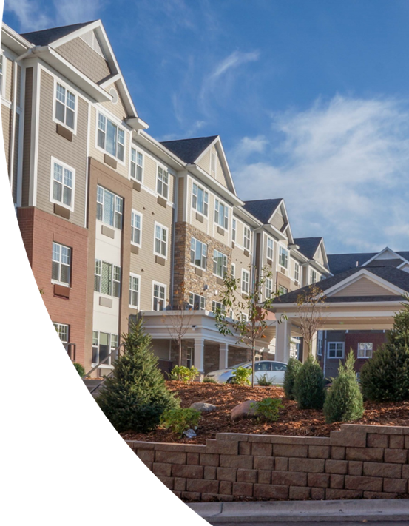
Agenda
Introductions
AALC’s
Financing
States
Underwriting
The Need in DC
Questions and Answers

Slide 3

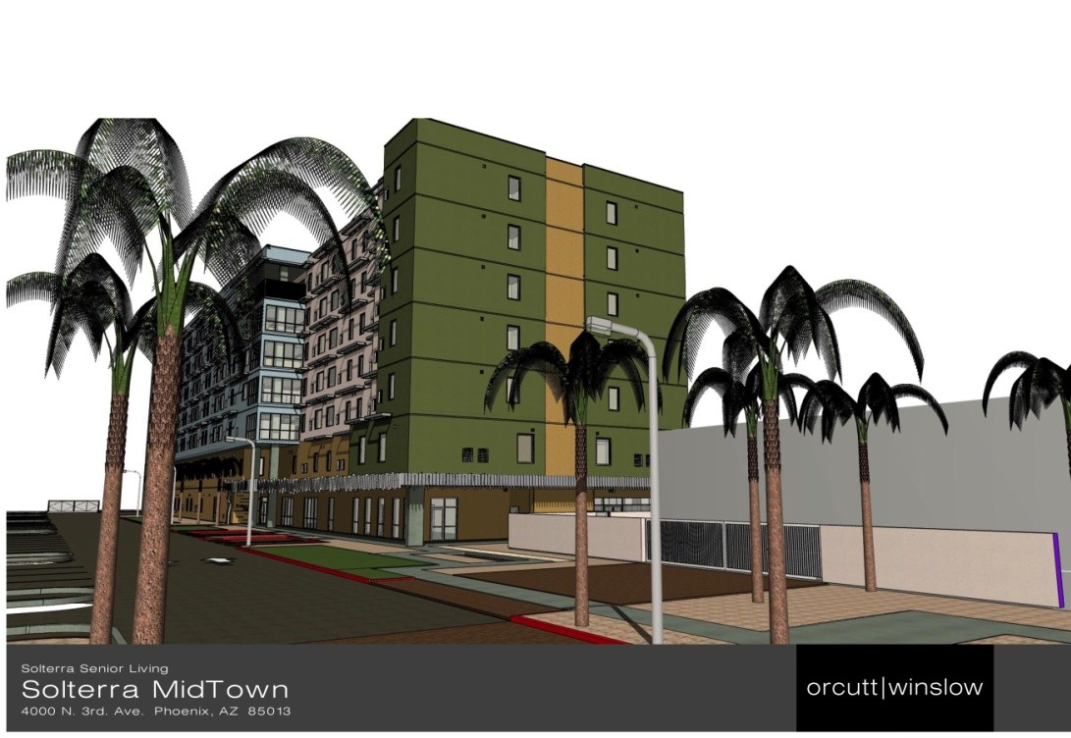
The Carding Group LLC
Partnership in AALC industry experts - CTF Capital Ltd, Downing & Company, Cardinal Court Capital
Over 2,500 units, 20 projects
Nearly $460MM in development of affordable assisted living communities in the last five years
Assist state agencies, non-profit & private developers and providers in implementing AALC programs
Bridgewater at Mid-Town, Phoenix, AX

Slide 4
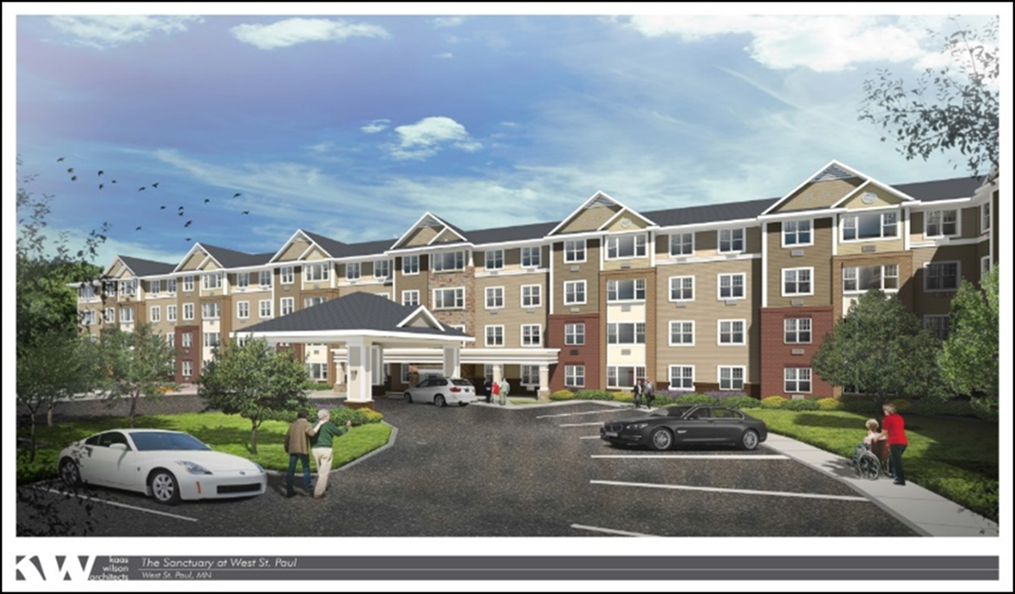
West St. Paul, Minnesota

Slide 5
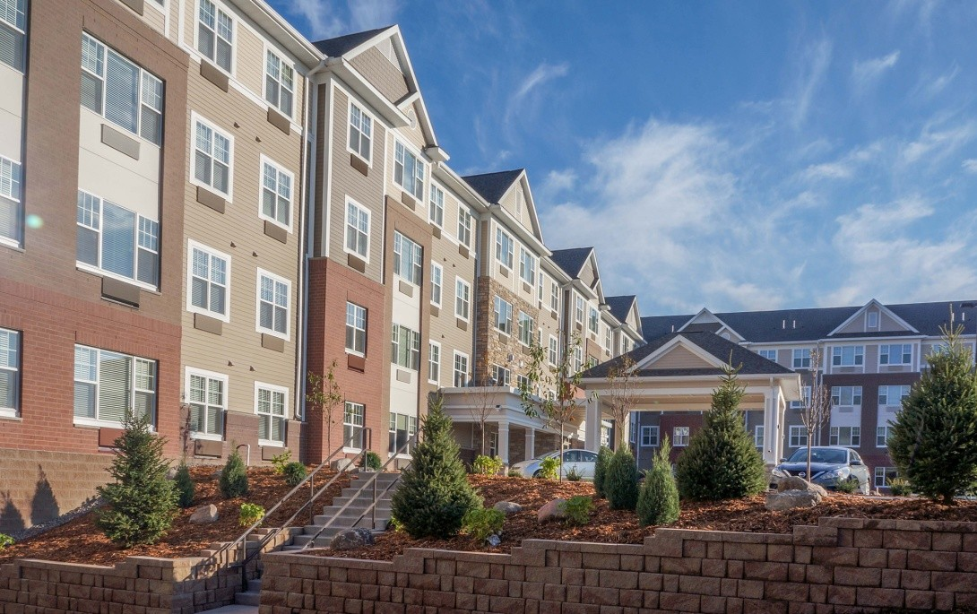
What is an AALC?
100% Affordable
80-100% are Medicaid eligible
Medicaid Elderly Waiver
Low Income Housing Tax Credits
Tax-Exempt Bonds
Significant Savings for State Budgets
20%-30% of nursing home Medicaid residents could be better and more economically served in AALC
Without AALC, most seniors in need of long-term care service must go to a nursing home or be taken care of by family
St Anthony’s, Lansing, IL

Slide 6
Nationwide Shift to AALC
Illinois expects to save up to $800 million by shifting residents from skilled nursing facilities to AALCs
New York has solicited proposals for 3,400 AALC beds to transition Medicaid costs from nursing homes to AALC, and expects a new round next year
New Jersey statutorily mandates MCOs contract to provide AALC beds
Indiana has developed 22 AALC communities in the last 5 years (over 2,500 units)
Arizona MCO’s are providing reimbursements rates above FFS rates

Slide 7
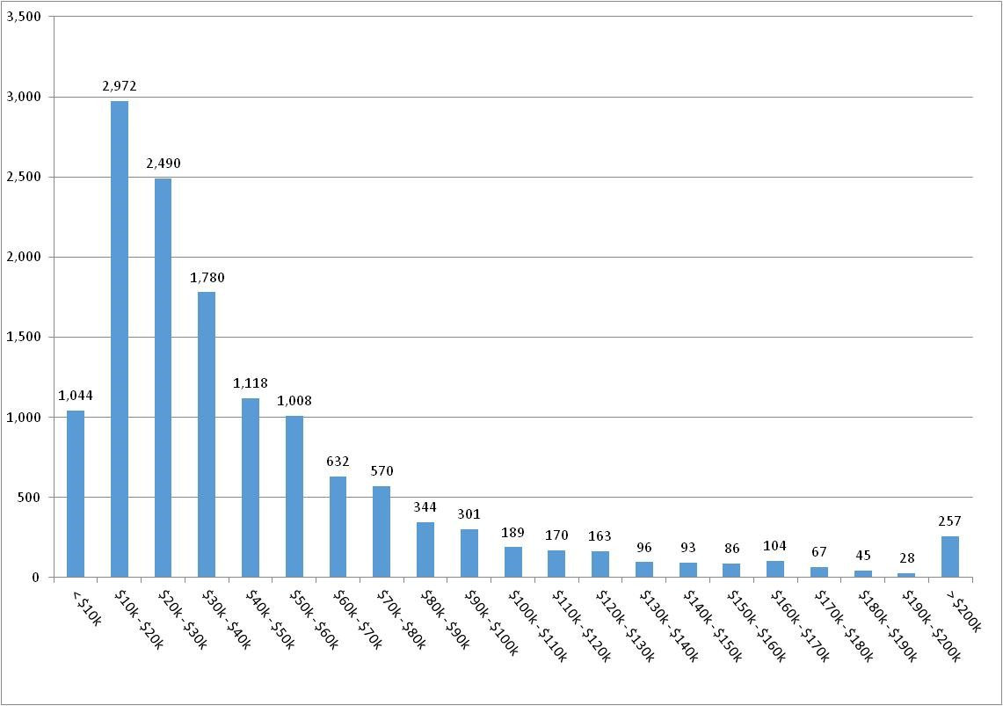
U.S. Senior Demographic - Income
2016 Income Distribution for 75+
Households
48% of 75+
households earn less than $30,000.
Medicaid eligibility starts at $27,000
Market rate Assisted Living Median Rent: $45,000/year nationally
Over 65% of 75+ households CANNOT afford this rent out of income
Seniors with incomes of 60% or less of median income qualify for reduced tax credit rents
Source: US Census, https://www.census.gov/data/tables/time-series/demo/income-poverty/cps-hinc/hinc-02.2016.html

Slide 8
How Are AALC’s Financed?
Tax exempt bonds and 4% low income housing tax credits (LIHTC)
Medicaid Waiver program (1915c)
Home and Community Based Setting (HCBS)
Rent is set at the Supplemental Security Income (SSI) amount less a personal allowance
Assisted living services are paid by Medicaid, rent paid by SSI
For most individuals the only alternative to AALC is a nursing home
Nationally, State Medicaid costs for nursing home residents are 50% higher than for HCBS waiver assisted living
Non-Medicaid residents’ rent is limited to 60% AMI under tax credit rents, AND
When you run out of savings, you can stay in your apartment

Slide 9
Tax-Exempt Bonds & LIHTC
Most AALC are financed with Tax-Exempt Bonds and tax credits (LIHTC)
Limited capital market demand for AALC debt and equity
No owner equity required
Hard Debt will be 60-75% of permanent financing, 1.30x – 1.40x DCR
Substantial Debt Service and Operating Reserves
LIHTC income limits
Housing vs. healthcare

Slide 10
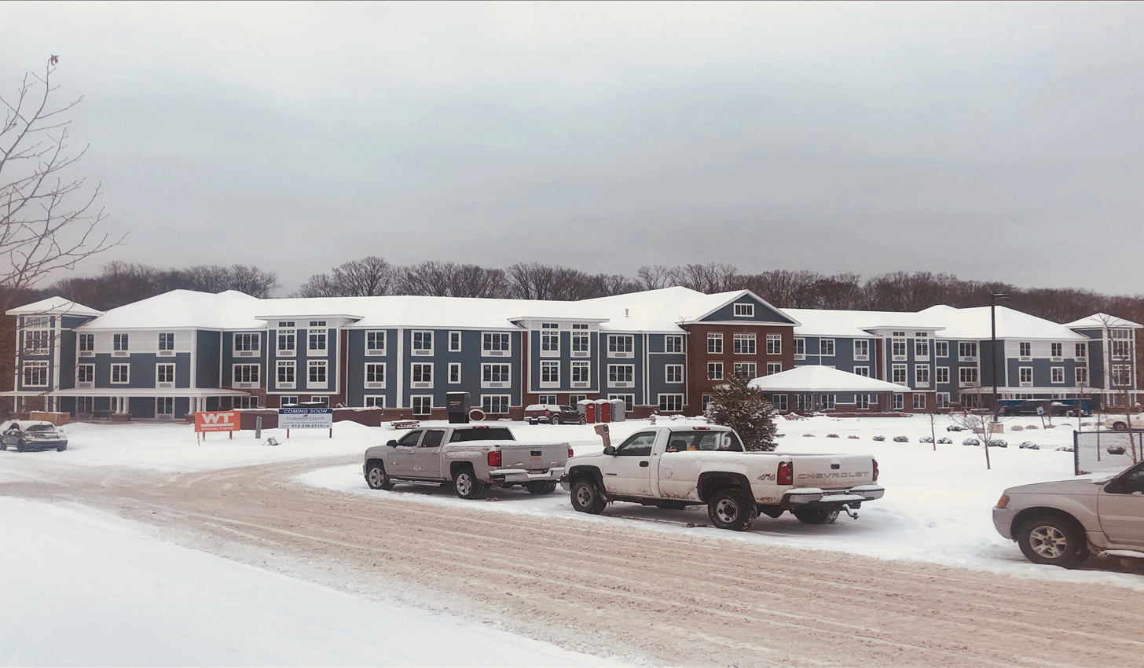
Evergreen Village, Bloomington, Indiana

Slide 11
Medicaid Elderly Waiver
States are required to provide long-term care for Medicaid-eligible elderly who need it. Mostly in nursing homes.
States can request a “waiver” from CMS to allow use of Medicaid for assisted living
Must need nursing home level of care
Waiver pays for services, while Room & Board (rent) is paid separately, by SSI
Service payment is set by State or MCO
Residents must have income below 300% of SSI and less than $2,000 in assets, ~$27,000/year
Program specifics are different in every state

Slide 12
State Medicaid Waiver Programs
State Medicaid waiver programs differ considerably
Acuity served or Level Of Care
Subsidy levels
Amount of income residents must contribute toward their care
Process for qualifying potential residents
Speed of reimbursement

Slide 13
Due Diligence on State Program
Does it provide enough revenue to operate the project with positive cash flow? Many state elderly waiver programs have inadequate reimbursement rates.
Process for qualifying prospective resident for assistance? Affects vacancy
How quickly will the state pay? If slow, affects cash flow. May necessitate an additional reserve for delayed payment or financing for receivables.

Slide 14
Assessing AL Waiver Programs
Reimbursement Rates
Limited slots
Personal Allowance & Cost Share
MCOs?
Process
Timing of reimbursements
Slow turnaround may necessitate an additional reserve for delayed payment
Housing Agency/Bond Issuer

Slide 15

Carding Group Activity
UP & RUNNING
MN
PRE-DEV
NY
MA
PLANNING
PA
NJ
IL, IN & OH
MD
EXPANSION
CO
VA
DC
AZ

Slide 16
Illinois
Supportive Living Facility Program, first in the nation
Specific licensing rules
Licenses approved on geographic/market basis (similar to CON)
Reimbursement rates are 60% of nursing home rate.
Geographically based
Resident spends 100% of income up to rate + room & board
Medicaid makes up any shortfall
$90/month for personal needs allowance
144 SLF projects built to date. Focus now is on dementia care

Slide 17
Indiana
Three levels of reimbursement based on acuity
Agency discussion on reworking/improving rate structure
Limited cost share – this is part of rate discussion
$53/month for personal needs allowance
AAAs assign level of care/reimbursement
10 AAAs
Housing agency is cautiously cooperative
22 AALCs built or in development
Carding Group contributed to all of them in some form

Slide 18
Arizona
Three levels of reimbursement based on acuity
MLTSS – received contracts soon after opening
This is close to this is the ideal
Cost Sharing
Veterans Benefits?
2 communities open, 1 under construction, 2 in planning

Slide 19
New Jersey
Single fee for service rate – too low
Single fee difficult in high cost states
Transitioning to MLTSS
Getting MCOs to understand real estate development
Issues with Issuing Agencies
Development generally more complex
1 under construction, 5 in planning

Slide 20
Minnesota
Dozen+ rate levels based on acuity – very complex
Includes dementia
Rates are MAXIMUMS
Mix of Fee for Service and MLTSS
Case management is challenging
3 communities in lease-up

Slide 21
Ohio
Three levels of reimbursement based on acuity
Rates are too low
Trying to Transition to MLTSS –
Need other income until MLTSS
Adult Day, Memory Care
Cost Sharing & $50 personal needs allowance
AAAs assign level of care/reimbursement
10 AAAs
Housing agency is skeptical
1 community under construction, 2 in planning

Slide 22
Colorado
Low reimbursement rate
Need mix-income, memory care
50% Affordable and 50% Market rate
PACE program to provide benefits
1 community in planning

Slide 23
MA, NY & PA
All are fantastic demographic markets
Five years of conversations MA & NY, 3 years in PA
Issues:
Politics
Competitive lobbies
Bureaucratic silos
Policy bias
NY has waiver and issue OFDs, but awards small projects
MA & PA need waiver or MLTSS

Slide 24
Maryland & Virginia
That’s why we’re here
Using Washington, DC, as a model
Maryland has waiver
Rates are too low - $62 & $78 per day

Slide 25
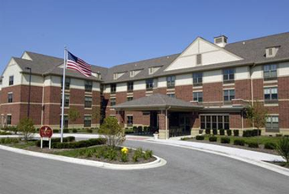
Deer Path, Huntly, IL

Slide 26
Revenue Sources
Room and Board (Rent)
LIHTC program restricted rents
Up to 80% area median income (AMI)
SSI less personal allowance
Medicaid waiver reimbursement (varies by state)
Pays for services
Services must be optional
Private Pay
10% - 20% discount to market rate comps

Slide 27
Market Potential
Medicaid Recipients -
Income below $2,250/month, $27,000/year
Less than $2,000 in assets
“Spend Down” -
Incomes below Medicaid threshold, but assets over $2,000
Qualify for Medicaid assistance when assets are below $2,000
Private Pay -
LIHTC qualified but over income for Medicaid. Income $27,000 to $49,260 (60% AMI) or up to $65,680 (80% AMI) for DC.
Market Rate –
Private pay residents
No subsidies, no LIHTC’s

Slide 28
Operating Expenses
Expenses average about $25,000/unit
High cost areas, such as DC, may be $40,000/unit
Designed and built as affordable
Tax abatements, exemptions
Addition to existing facility (nursing home, independent living)
Heightened Scrutiny

Slide 29
Reserves
Operating Reserve
3-6 mos of D/S and expenses
Lease-Up & Marketing Reserve
Projects take longer to rent up unlike other affordable housing
Replacement Reserve
$400-500/unit annually
Medicaid Payment Reserve
Delay from state to pay
Capitalized Interest
24 months of capitalized interest

Slide 30
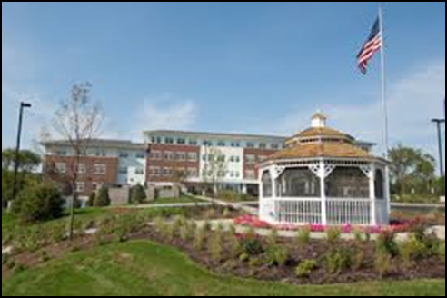
Oak Hill in Round Hill, IL

Slide 31
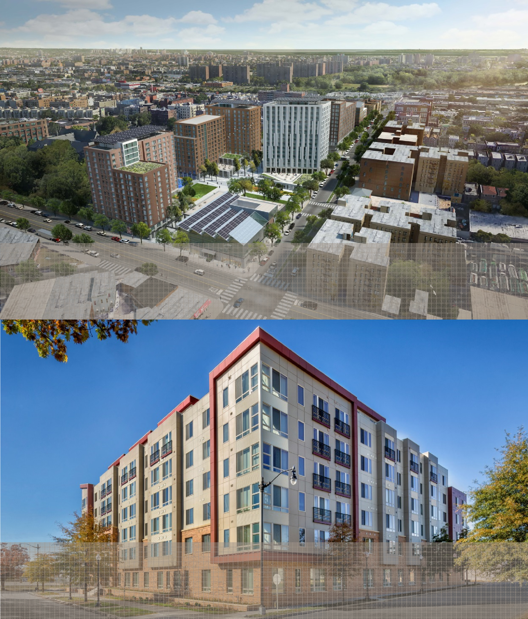

The Peninsula
Bronx, NY
Real estate development, investment and property management arm of Gilbane Inc., a financially stable, family owned company since 1873
Over $5 Billion in total development
Over 51,000,000 SF of development
7,400+ units of housing developed/underway
The Grove at Parkside
Washington, DC

Slide 32
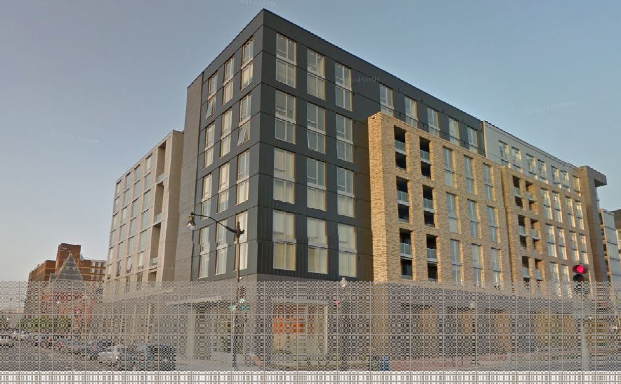
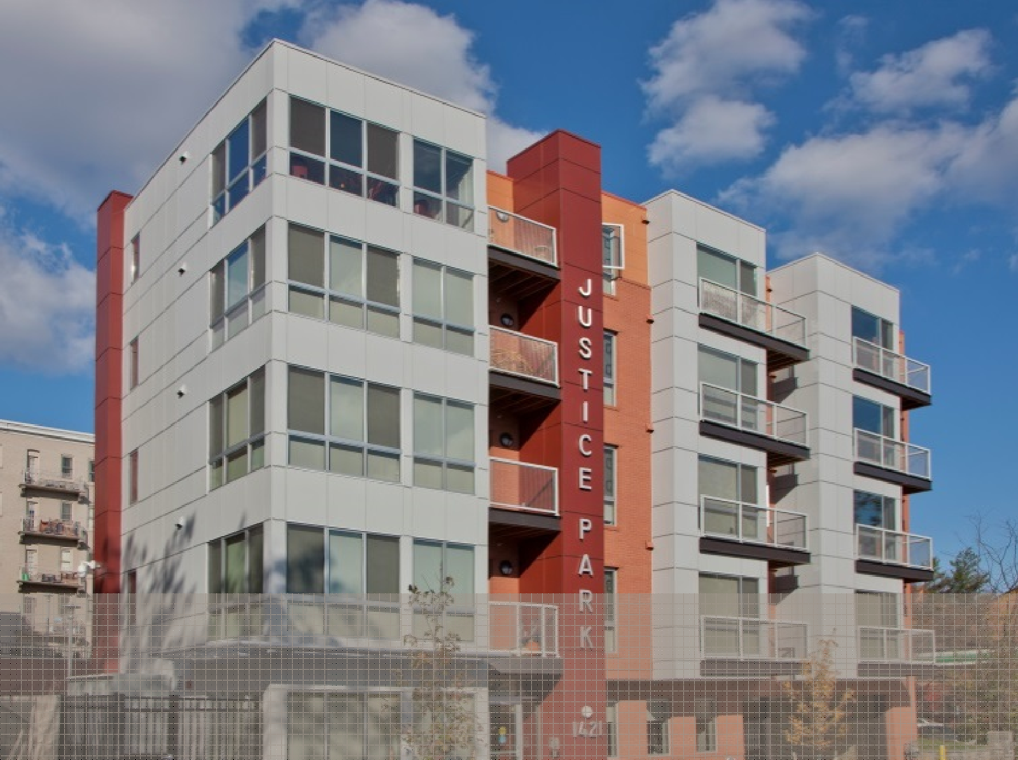
CBE-Certified
Extensive financing experience:
19 Deals Closed
9 Tax Credit Deals Closed
$50 million in Tax-Exempt Bond Financing Secured
$50 million in Public Subsidy Secured
$381 million in Commercial Real Estate Financing Secured
1,189 Units Financed and under construction
The Hodge
Washington, DC
Justice Park Apartments
Washington, DC

Slide 33
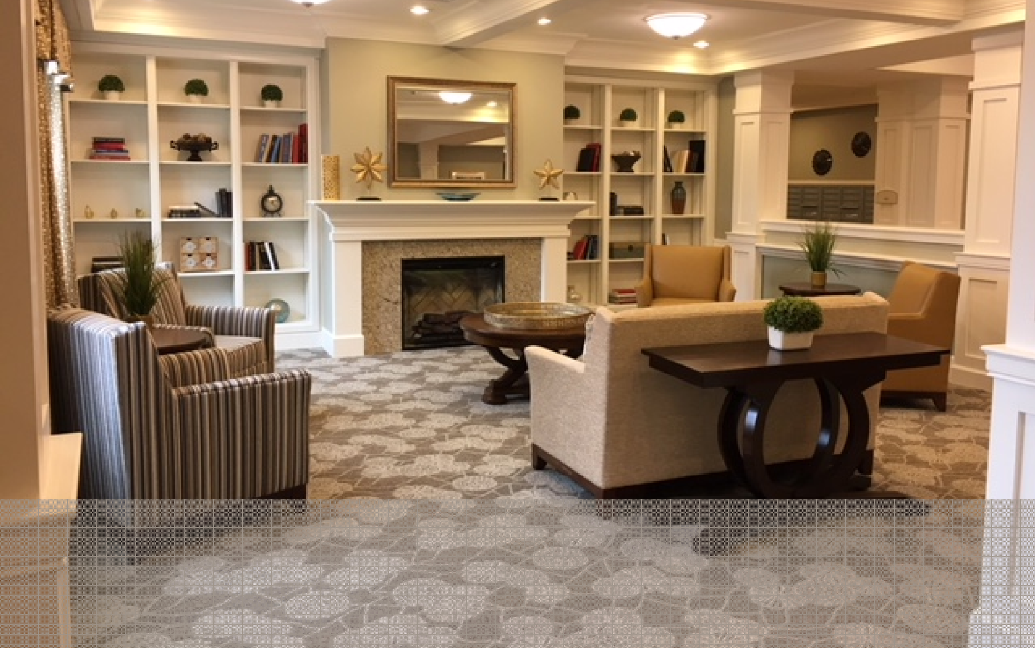

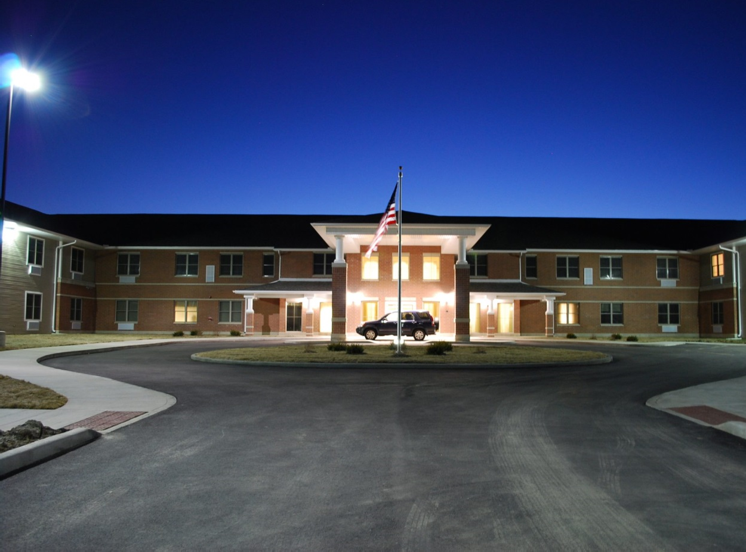

15+ years of developing and operating senior living, assisted living and memory care communities
14th largest assisted living provider in the U.S.
Communities maintain occupancy rates nearly 10% higher than national averages
Operating margins consistently rank in the top 25% nationally
Hellenic Senior Living
New Albany, IN
Heritage Woods
Sterling, IL

Slide 34
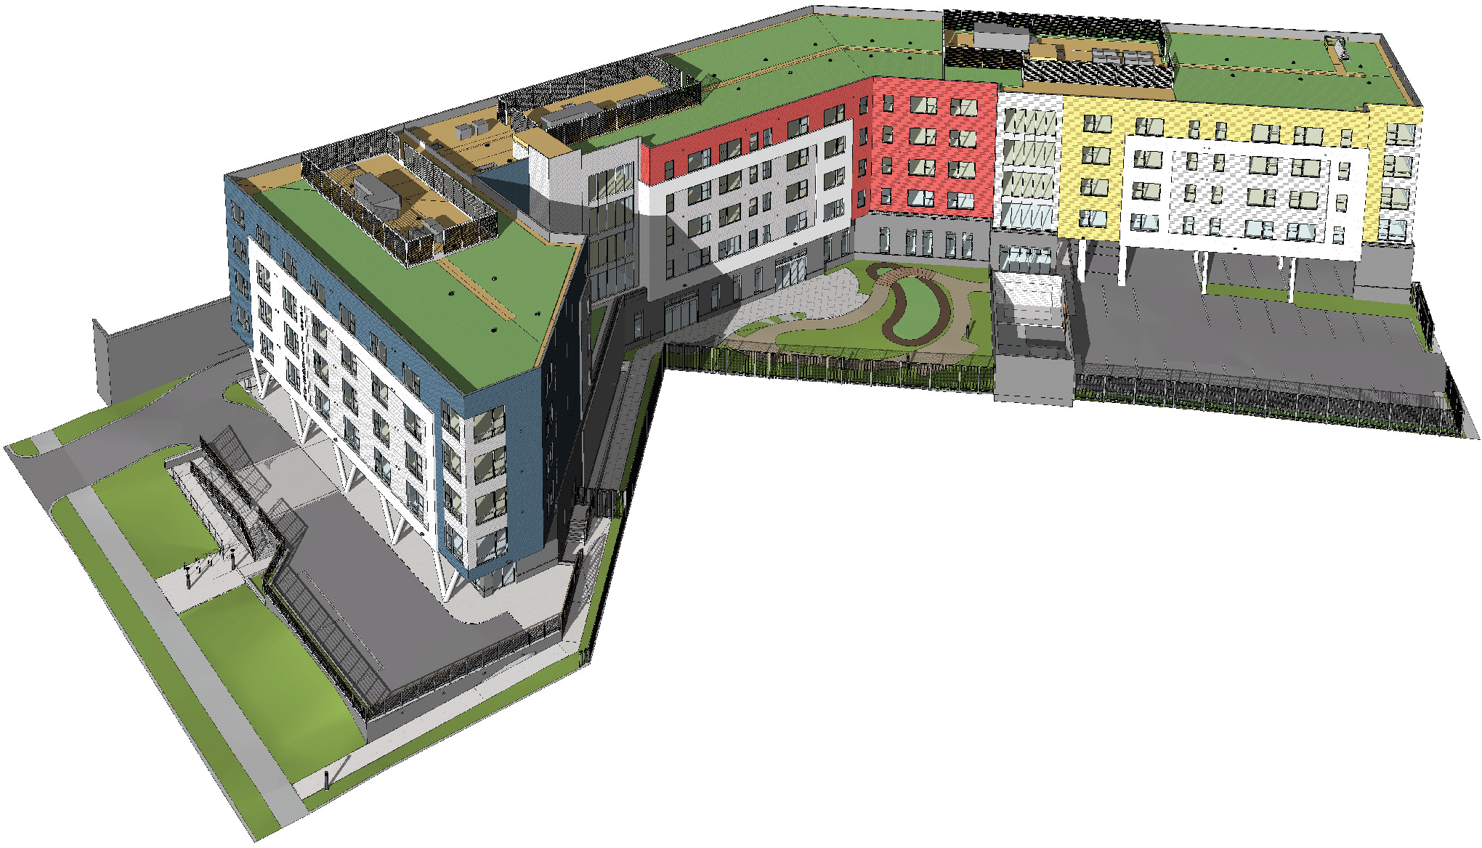
Exterior Rendering

Slide 35
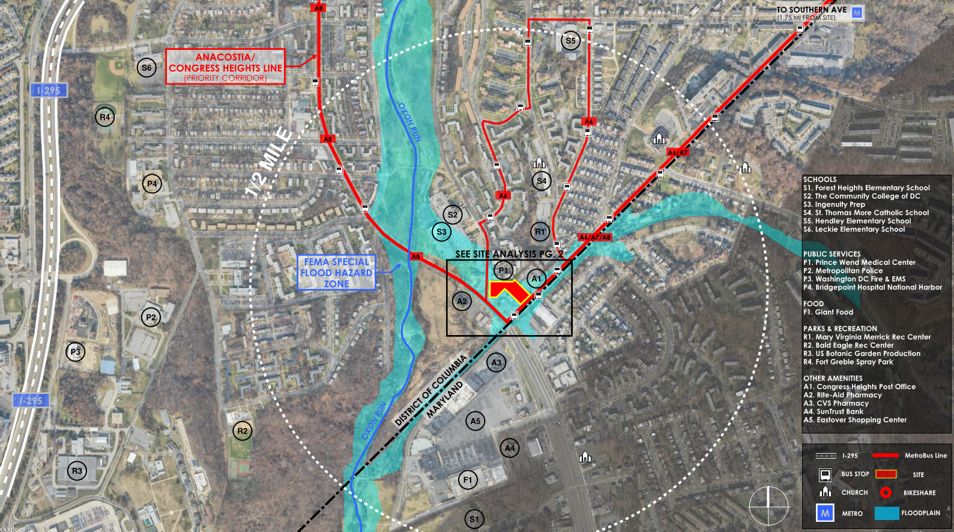
SOUTHERN AVENUE AAL

Slide 36
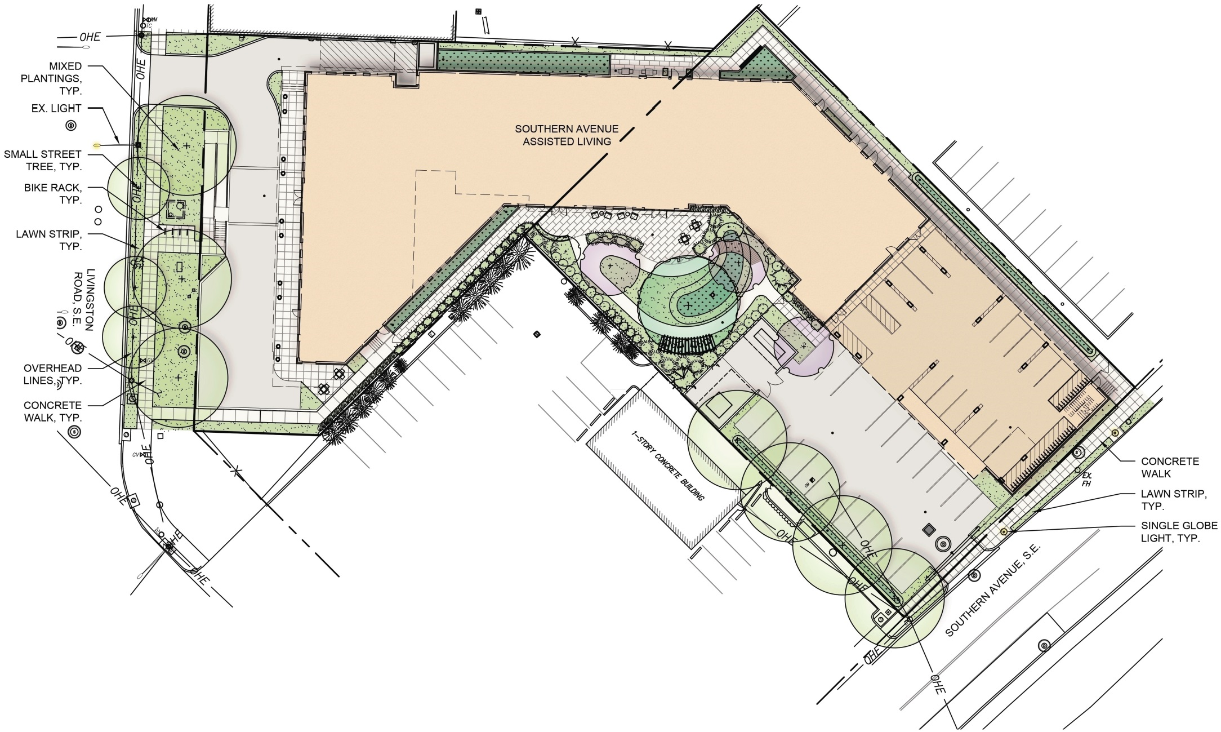
SITE PLAN

Slide 37
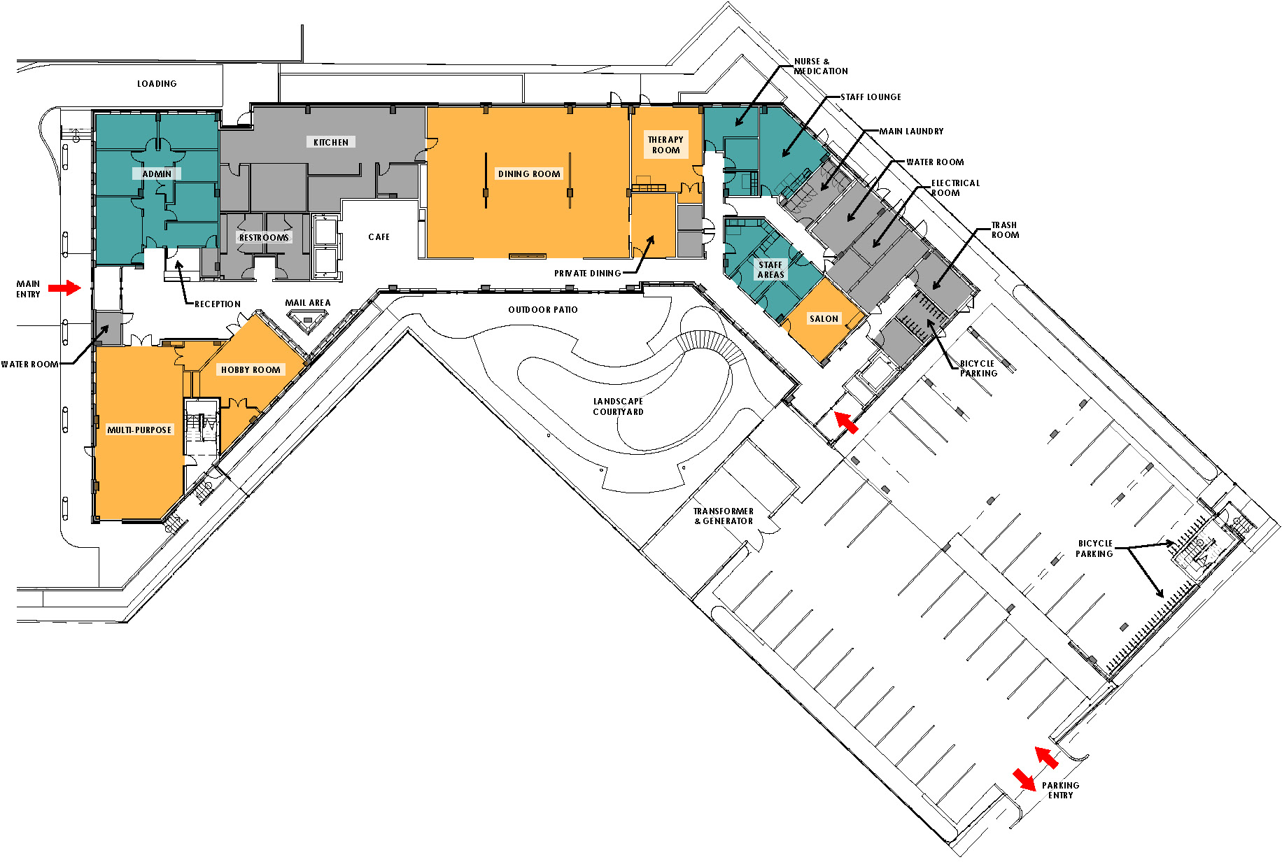
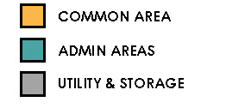
GROUND FLOOR PLAN

Slide 38
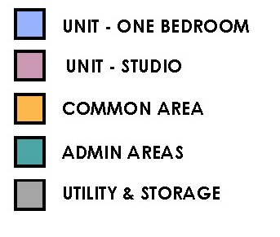
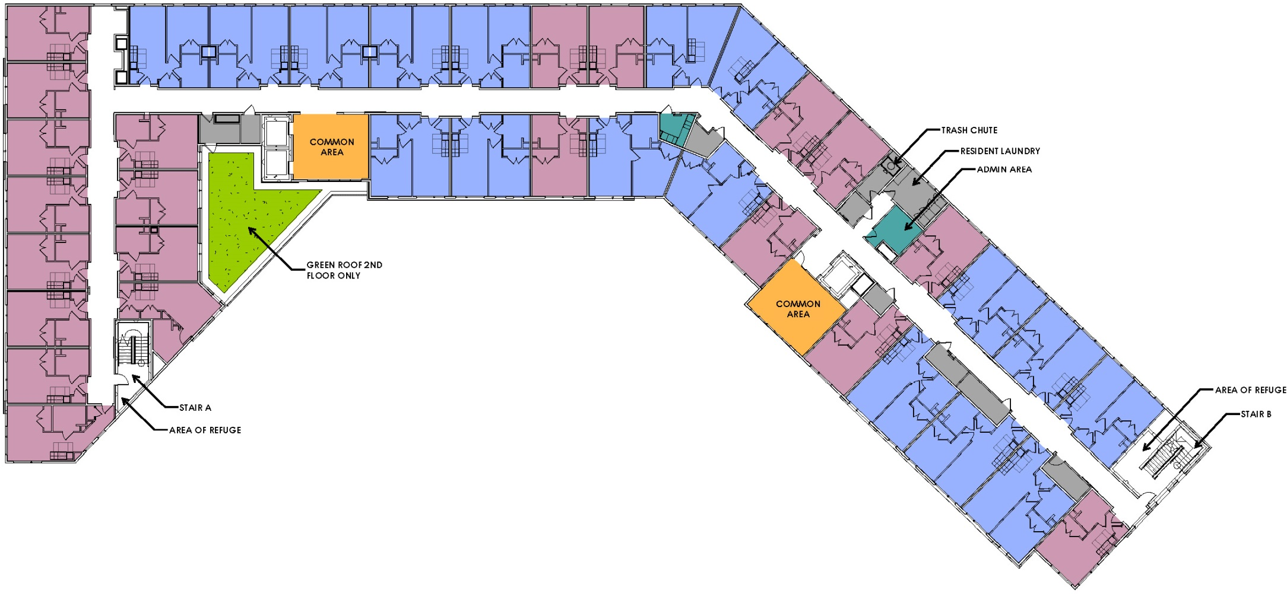
TYPICAL FLOOR PLAN

Slide 39


Interior Rendering

Slide 40




Questions
June 16, 2018 21

