Slide 1

Long-Term Care in DC A Roadmap to 2028
October 5, 2018

Slide 2
“Aging in Community” a complex set of considerations
Health
Physical, mental and social well-being
Housing
Community
Connections and familiarity to avoid isolation
Mobility
Safe and suited to meet individual needs
Getting around, activities of daily living, transportation
Individual
Culture
Ethnic, racial, religious, social differences
Support
Navigate complexities/find solutions
Cost
Access
Ability to finance needs and objectives
Preventive, supportive and curative services across levels of care

Slide 3
Our focus
Options that will allow us to age in our DC communities
Particularly for middle income, frail older adults
Largely focused on housing
A trained and sufficient workforce (and supportive technology)
Our objective
Define and prioritize a potential set of next steps / actions
Build a constituency to focus on LTC for middle income aging adults
Educate government officials and key stakeholders to advance our priorities
Agreed upon action plan allowing lead time for build of housing and workforce

Slide 4
a defining issue of our time
2030 will be a historic turning point. All baby boomers will surpass age 65.
1 in 5 Americans will be of retirement age.¹
Aging Population
Long-Term Care
78M will be over 65 in 2035¹
Older households with disability to increase by 76% to 31.2M by 2035²
~70% will eventually need help with bathing, food preparation, dressing, and medication management³
20% needing LTC are in institutional and 80% in home/community settings³
Demand for affordable, memory care, chronic and post acute care options
Opportunities for public / private partnerships and investment
Aging in Community
Workforce
88% of senior households wish to stay in home and 89% in community⁴
3.5% of homes offer 1 floor, wide halls/doors, and zero-step entrance²
Decrease in family caregivers; in-home care cost prohibitive for many lower and middle income
<3% of medical students choose geriatric electives⁵
IOM Est need for 3.5M LTC workers by 2030 to maintain current ratios⁵
Increasing ethnic/racial diversity, workforce shortage, wages, licensure and training are all considerations
¹US Census Bureau 2017 National Population Projections, September 2017
²Projections and Implications for Housing a Growing Population: Older Households 2015-2035, Harvard Joint Center For Housing Studies, December 2016
³Rising Demand for LTSS for Elderly, Congressional Budge Office, June 2013
⁴Healthy Aging Begins at Home, Bipartisan Policy Center, 2014 AARP Survey, May 2016
⁴Retooling An Aging America, Building the Health Care Workforce, Institutes of Medicine Issue Brief, Eldercare Workforce Alliance, 2008

Slide 5
a defining issue of our time
2030 will be a historic turning point. All baby boomers will surpass age 65.
1 in 5 Americans will be of retirement age.¹
Aging Population
Long-Term Care
78M will be over 65 in 2035¹
Older households with disability to increase by 76% to 31.2M by 2035²
~70% will eventually need help with bathing, food preparation, dressing, and medication management³
20% needing LTC are in institutional and 80% in home/community settings³
Demand for affordable, memory care, chronic and post acute care options
Opportunities for public / private partnerships and investment
Aging in Community
Workforce
88% of senior households wish to stay in home and 89% in community⁴
3.5% of homes offer 1 floor, wide halls/doors, and zero-step entrance²
Decrease in family caregivers; in-home care cost prohibitive for many lower and middle income
<3% of medical students choose geriatric electives⁵
IOM Est need for 3.5M LTC workers by 2030 to maintain current ratios⁵
Increasing ethnic/racial diversity, workforce shortage, wages, licensure and training are all considerations
¹US Census Bureau 2017 National Population Projections, September 2017
²Projections and Implications for Housing a Growing Population: Older Households 2015-2035, Harvard Joint Center For Housing Studies, December 2016
³Rising Demand for LTSS for Elderly, Congressional Budge Office, June 2013
⁴Healthy Aging Begins at Home, Bipartisan Policy Center, 2014 AARP Survey, May 2016
⁴Retooling An Aging America, Building the Health Care Workforce, Institutes of Medicine Issue Brief, Eldercare Workforce Alliance, 2008

Slide 6
a defining issue of our time
2030 will be a historic turning point. All baby boomers will surpass age 65.
1 in 5 Americans will be of retirement age.¹
Aging Population
Long-Term Care
78M will be over 65 in 2035¹
Older households with disability to increase by 76% to 31.2M by 2035²
~70% will eventually need help with bathing, food preparation, dressing, and medication management³
20% needing LTC are in institutional and 80% in home/community settings³
Demand for affordable, memory care, chronic and post acute care options
Opportunities for public / private partnerships and investment
Aging in Community
Workforce
88% of senior households wish to stay in home and 89% in community⁴
3.5% of homes offer 1 floor, wide halls/doors, and zero-step entrance²
Decrease in family caregivers; in-home care cost prohibitive for many lower and middle income
<3% of medical students choose geriatric electives⁵
IOM Est need for 3.5M LTC workers by 2030 to maintain current ratios⁵
Ethnic/racial diversity, workforce shortage, wages, licensure and training are all complex factors
¹US Census Bureau 2017 National Population Projections, September 2017
²Projections and Implications for Housing a Growing Population: Older Households 2015-2035, Harvard Joint Center For Housing Studies, December 2016
³Rising Demand for LTSS for Elderly, Congressional Budge Office, June 2013
⁴Healthy Aging Begins at Home, Bipartisan Policy Center, 2014 AARP Survey, May 2016
⁴Retooling An Aging America, Building the Health Care Workforce, Institutes of Medicine Issue Brief, Eldercare Workforce Alliance, 2008

Slide 7
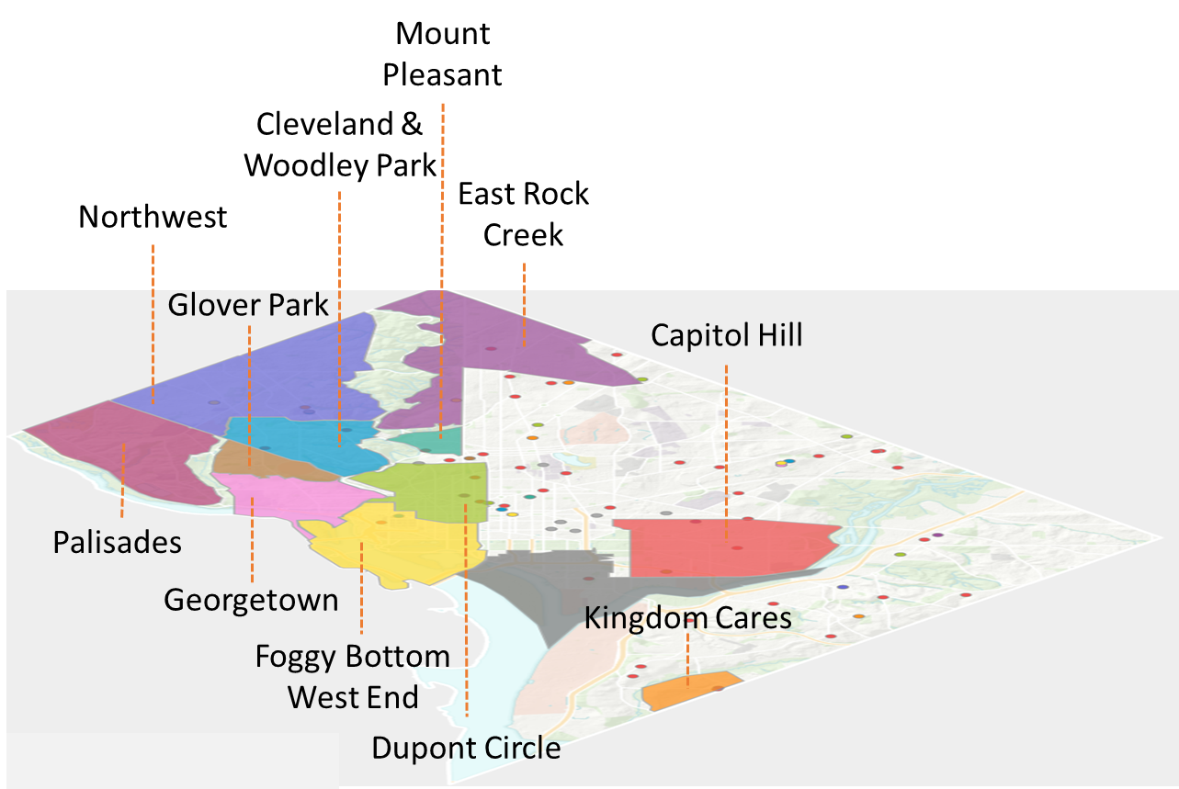
Senior Villages Across DC One Integral Component to “Aging in Place”
There are 25% more seniors in DC than children in K-12 public schools. 52% live alone and 17% live in poverty.
Grassroots based
Not-for-profit
Trusted relationships -- neighbors & community
Links to volunteer and paid services
Dues and subsidized membership
$300K DCOA Funding, grants, other (varies)

Slide 8
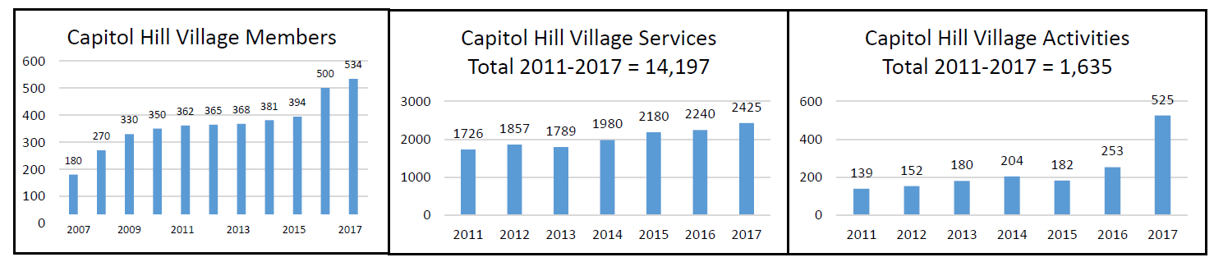
Capitol Hill Village Supporting Seniors, Families and DC Villages
Keeping seniors socially engaged, continually learning, safe and connected. Supporting families through education, resources and referrals.
Volunteer services
Care services
Social activities
Transportation outreach
Vetted vendors
Educational programs
Wellness programs
Civic engagement
Partnerships

Slide 9
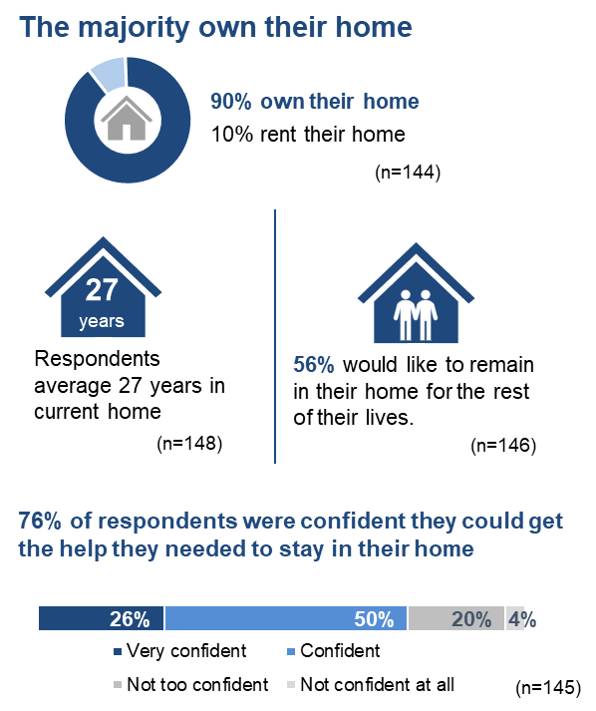
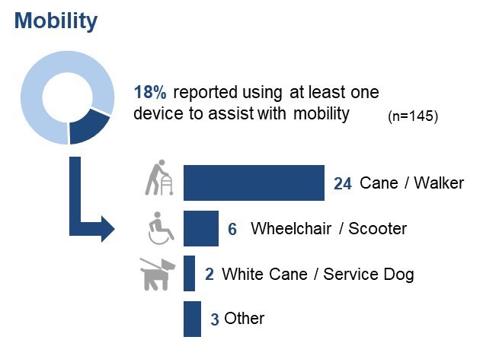
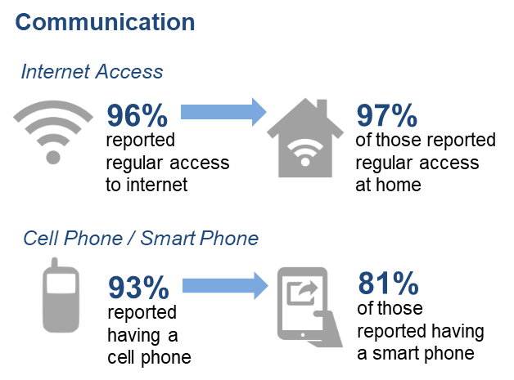
A Snapshot of chv survey respondents
¹ The 2018 Village Transportation Survey was completed by a convenience sample of 150 individuals, with approximately 70% completing the survey online.
Percentages may not total 100% due to rounding.

Slide 10
Frail Older Adults in dc
33% (or 24,000) of DCs 65+ population have one or more “difficulties” as defined by the US Census Bureau¹
Self-Care
Vision
Hearing
Independent
Living
Ambulatory
Cognitive
49% have difficulty living independently | Of those who have difficulty living independently
47% have difficulty walking 30% have difficulty with self-care 26% have a cognitive disability | ~3,000 are married ~4,000 live alone (30% are men) ~2,600 women live with other family
¹US Census Bureau, American Community Survey, 2012 – 2016 averages; analysis by Doug Hillmer

Slide 11
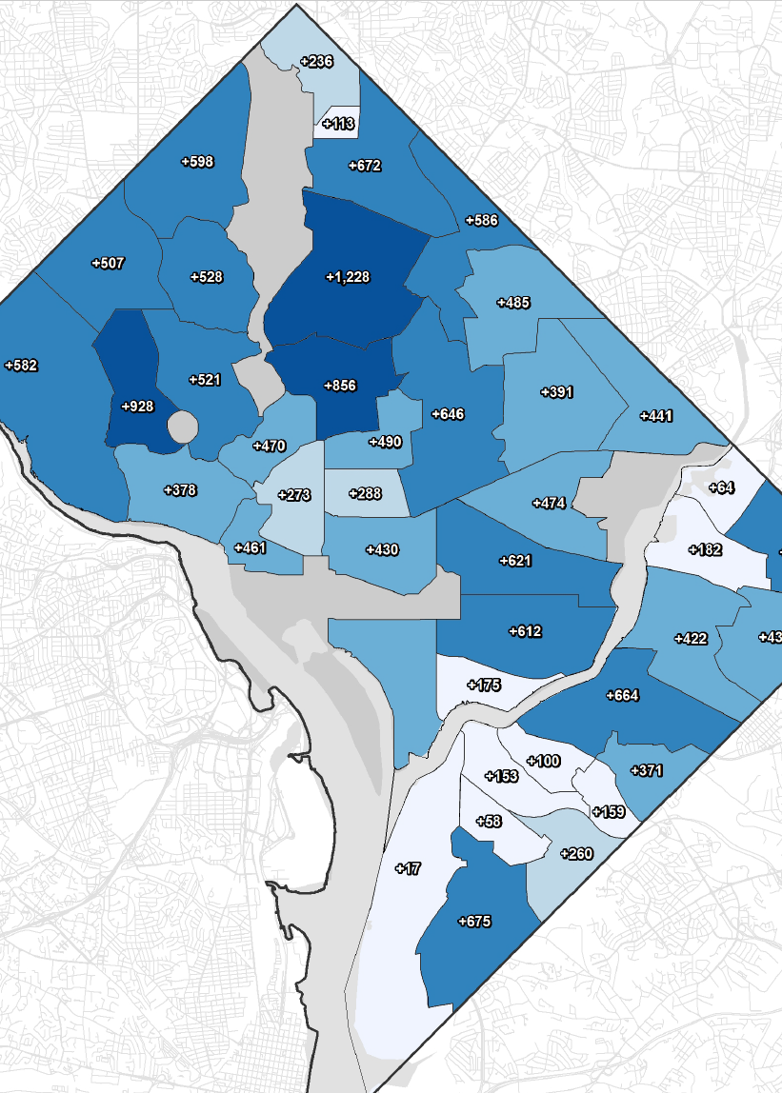
Darkest blue shows highest projected growth in seniors 2015 – 2025
~52% will need LTC at some point¹
By 2028 DC’s 65+, with a disability population to increase up to 30%
27 out of 100 will need long term care for 2 years or less
14 out of 100 will need long-term care for 5 years or more¹
Assisted Living Units
15 facilities
Capacity for 851 residents
50% of wards have NO facilities
Representing 49% adults 60 to 85+²
>200 (1)
120-135
50-60
30-49 (4)
8-15 (2)
Day Programs & Capacity
Downtown Cluster (45-48)
Brookland (60)
Forest Side Memory Care (10)
Iona (50)
¹How the Medicaid Debate Affects Long-Term Care Insurance Decisions, Ron Lieber, New York Times, July 14, 2017
²District of Columbia Office of Planning/State Data Center, September 8, 2015

Slide 12
Housing / Program definitions

Slide 13
Income levels – a critical consideration
Sources: Retirement Living Sources Book, Summer 2018; U.S. Census 2012-2016 ACS, Public Use Microdata Sample

Slide 14
Choices by household income – those with difficulty
Sources: Retirement Living Sources Book, Summer 2018; U.S. Census 2012-2016 ACS, Public Use Microdata Sample

Slide 15
Choices by household income – those with difficulty
Sources: Retirement Living Sources Book, Summer 2018; U.S. Census 2012-2016 ACS, Public Use Microdata Sample

Slide 16
Choices by household income – those with difficulty
Sources: Retirement Living Sources Book, Summer 2018; U.S. Census 2012-2016 ACS, Public Use Microdata Sample

Slide 17
Choices by household income – those with difficulty
Sources: Retirement Living Sources Book, Summer 2018; U.S. Census 2012-2016 ACS, Public Use Microdata Sample

Slide 18
Discussion What can we achieve by 2028?

Slide 19
Our focus
Options that will allow us to age in our DC communities
Particularly for middle income, frail older adults
Largely focused on housing
A trained and sufficient workforce (and supportive technology)
Our objective
Define and prioritize a potential set of next steps / actions
Build a constituency to focus on LTC for middle income aging adults
Educate government officials and key stakeholders to advance our priorities
Agreed upon action plan allowing lead time for build of housing and workforce

Slide 20
Scenarios to help our discussion
Low income couple, do not qualify for Medicaid. Increasing difficulty getting around home.
Middle income couple, not enough resources to pay full costs. Husband has dementia.
High income couple, both have dementia (one mild / on serious).
Couple below the poverty line. She has advanced dementia and is in a nursing home an hour from her husband who must live with his house, car and no more than $4000 in cash assets.
Middle income single, lives alone. Has a stroke. Still in relatively good health, but needs skilled nursing

Slide 21
Next Steps

